Slide 1
CHIPP - CSCS F2F meeting
ETHZ, Zürich
September 1st , 2016

Slide 2
Tier 2 status and plans CSCS
Statistics
Availability/Reliability
CPU usage
Storage usage
Operations
Updates
Main Issues
Plans
Phases of Phoenix
Pledges
Open discussion:
Memory Usage
Support Changes

Slide 3
Statistics

Slide 4
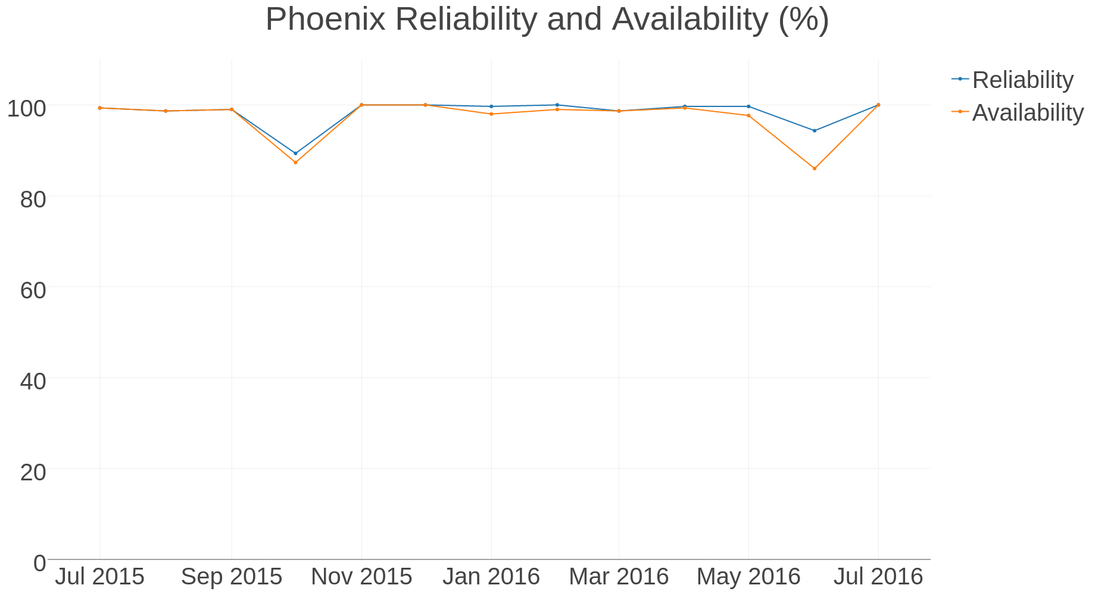
Statistics
Two maintenances in one month (dCache issue)
Incident/Maintenance on IB network

Slide 5
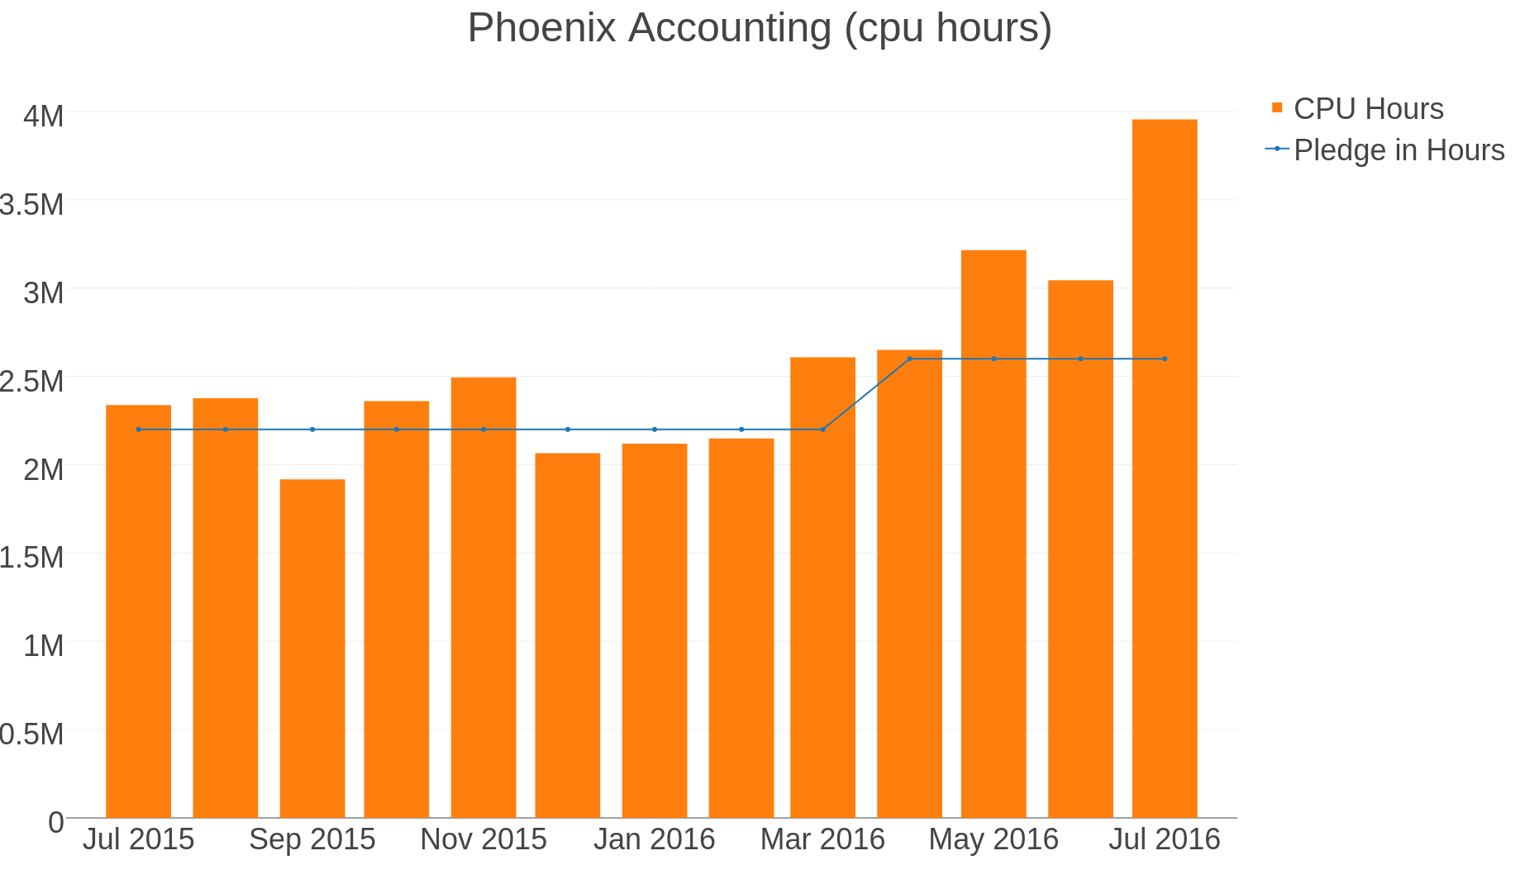
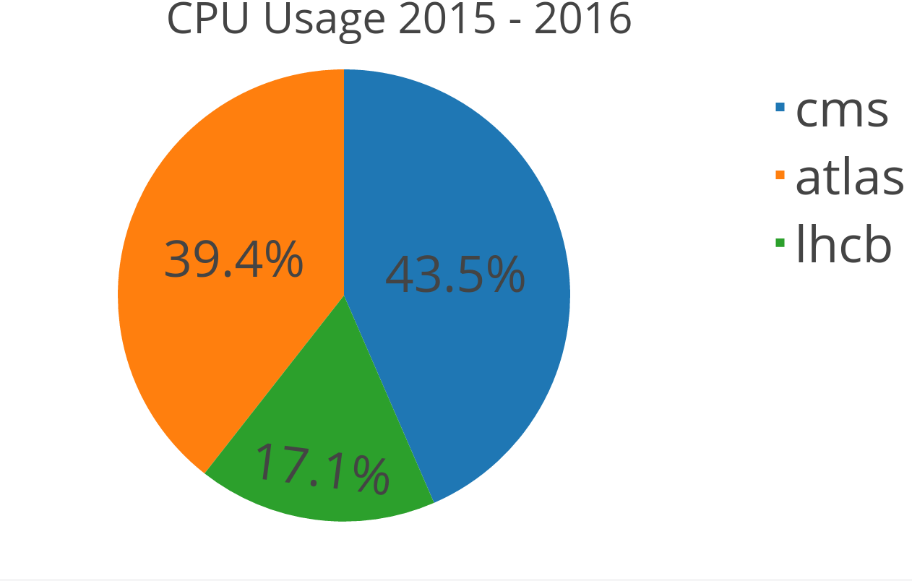
Statistics – CPU usage

Slide 6
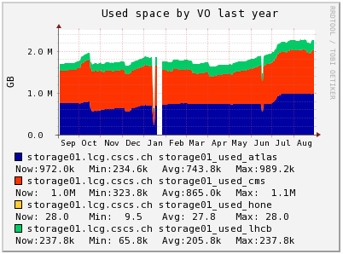
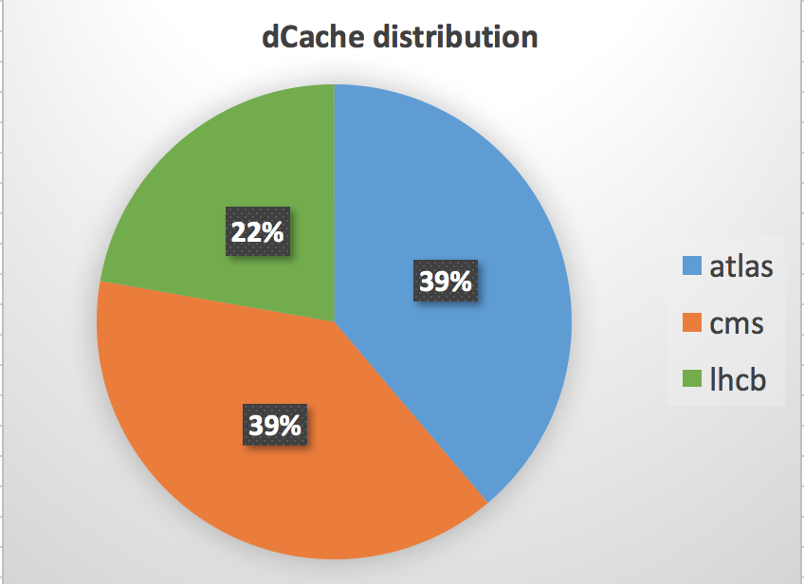
Statistics – Storage usage (2/2)
Allocated space
atlas 1377.6 TB
cms 1383.6 TB
lhcb 789.8 TB

Slide 7
Operations

Slide 8
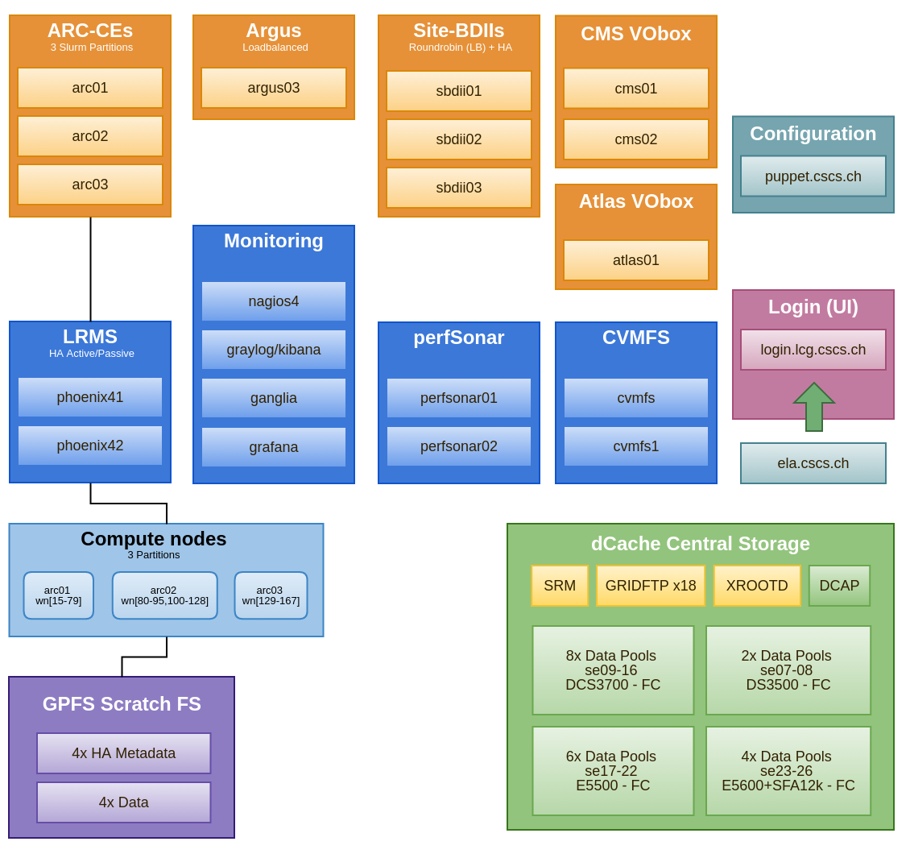
Operations – Updates: Phoenix Services Overview

Slide 9
Operations – Updates since march 2016:
All partition are shared between the VOs
Partition | WNs | CPU | Cores
arc01 | wn[15-79] | Xeon(R) CPU E5-2670 0 @ 2.60GHz | 32
arc02 | wn[80-128] | Xeon(R) CPU E5-2680 v2 @ 2.80GHz | 40
arc03 | wn[129-167] | Xeon(R) CPU E5-2680 v4 @ 2.40GHz | 56
TOTAL | 149 |  | 6080
Cluster completely re-installed with Puppet
still missing VO boxes
All VMs services now running on CSCS VMware infrastructure
New worked nodes installed and updated to v4
New Slurm (v15.08) and ARC CE Setup. CREAM CE decommisioned

Slide 10
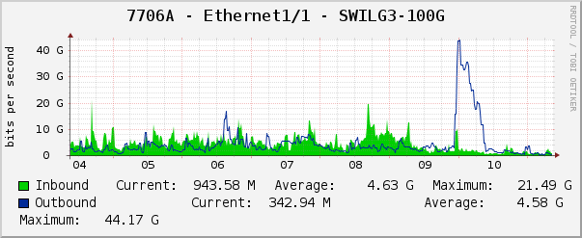
Operations – Updates since march 2016:
BDII reinstalled in HA mode with Keepalived and floating Ips
3 BDII with 3 floating ip and load distribution (Round Robin), in case of failure ip will be moved to the one alive
perfsonar puppetized and reinstalled
Using CSCS central log/dashboards/metrics facility
Mirroring to log.lcg.cscs.ch, kibana.lcg.cscs.ch and graylog.lcg.cscs.ch
Local elasticsearch instances/local kibana dashboards (Demo)
Allocated 1PB to dCache
Integrated the storage into the CSCS SAN
New CHIPPonCRAY Scratch

Slide 11
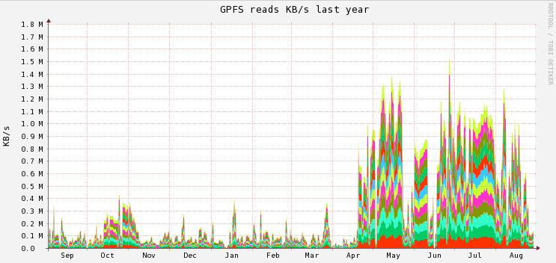
GPFS Reads last year

Slide 12
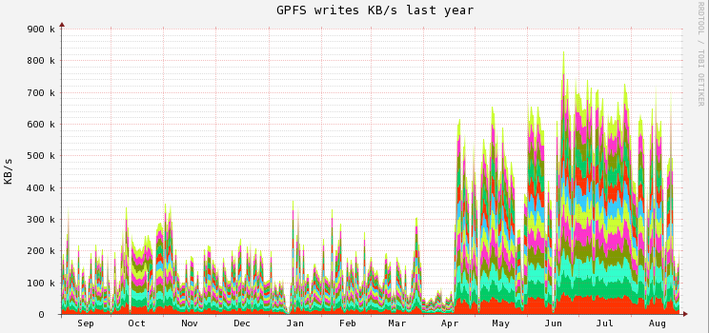
GPFS Writes last year

Slide 13
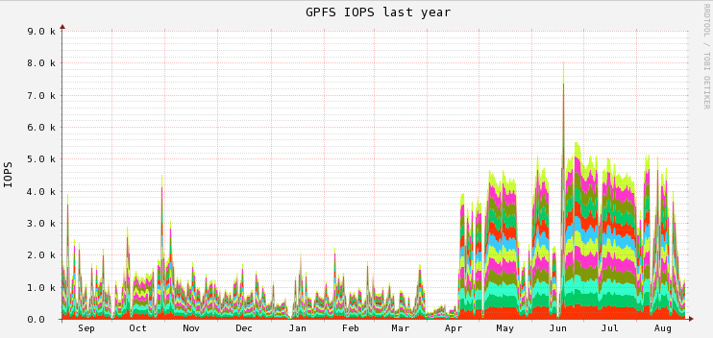
GPFS IOPS last year

Slide 14
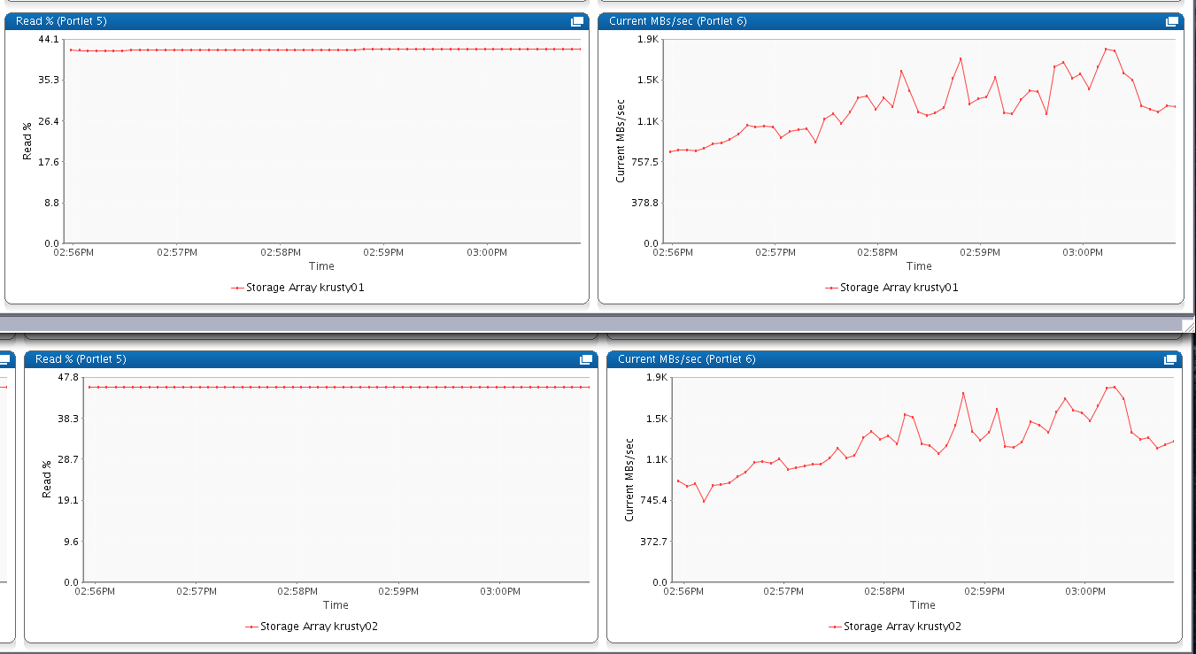
Scratch performance during high load

Slide 15
Operations – Main issues
Inodes – April 2016
Set quota limits user based on fileset
Net-IB – June
Replaced few cables
OFED upgraded and alined around the cluster
Datagram mode enable everywhere
Lcg-util/Scratch – July
Moved to gfal2-util (VO related config)
GPFS tuning for the new load

Slide 16
Plans

Slide 17
Plans – Phases of Phoenix
2013
2014
2015
2016
2017
Phase H
Phase J
Phase K
Phase L
Phase M
NOW

Slide 18
Plans – Pledges
Plans for 2017
Storage:
Today 3.4 PB
Decommission ~0.8 PB
Buy ~1 PB
Total 3.6 PB
Pledge 3.5 PB
Cost ~250K CHF
Compute:
Today 69K HS06
Decommission 3% (~2K HS06)
Buy ~12K
Total 79K HS06
Pledge 62K HS06
Cost ~200K CHF
Need to set pledges for Phase M
Phase | Compute power pledged [HS06] | Storage pledged [TB]
Phase H – April 2014 | 26000 | 1800
Phase J – April 2015 | 35000 | 2300
Phase K – April 2016 | 49000 | 3070
Phase L – April 2017 | 62000 | 3500
Phase M – April 2018 | 72000 | 4000
Scratch:
~ 6 new NSD servers for Scratch (Cost ~ 40K CHF)
GPFS License Cost ~ 60K CHF
Network:
Replacement of old IB switches (Cost ~30K CHF)
VMWARE (Cost ~20K CHF)
Notes:
----- Meeting Notes (08/03/16 12:04) -----
Change Phase J stoirage pledge to 2300 instead 2000

Slide 19
Discussion

Slide 20
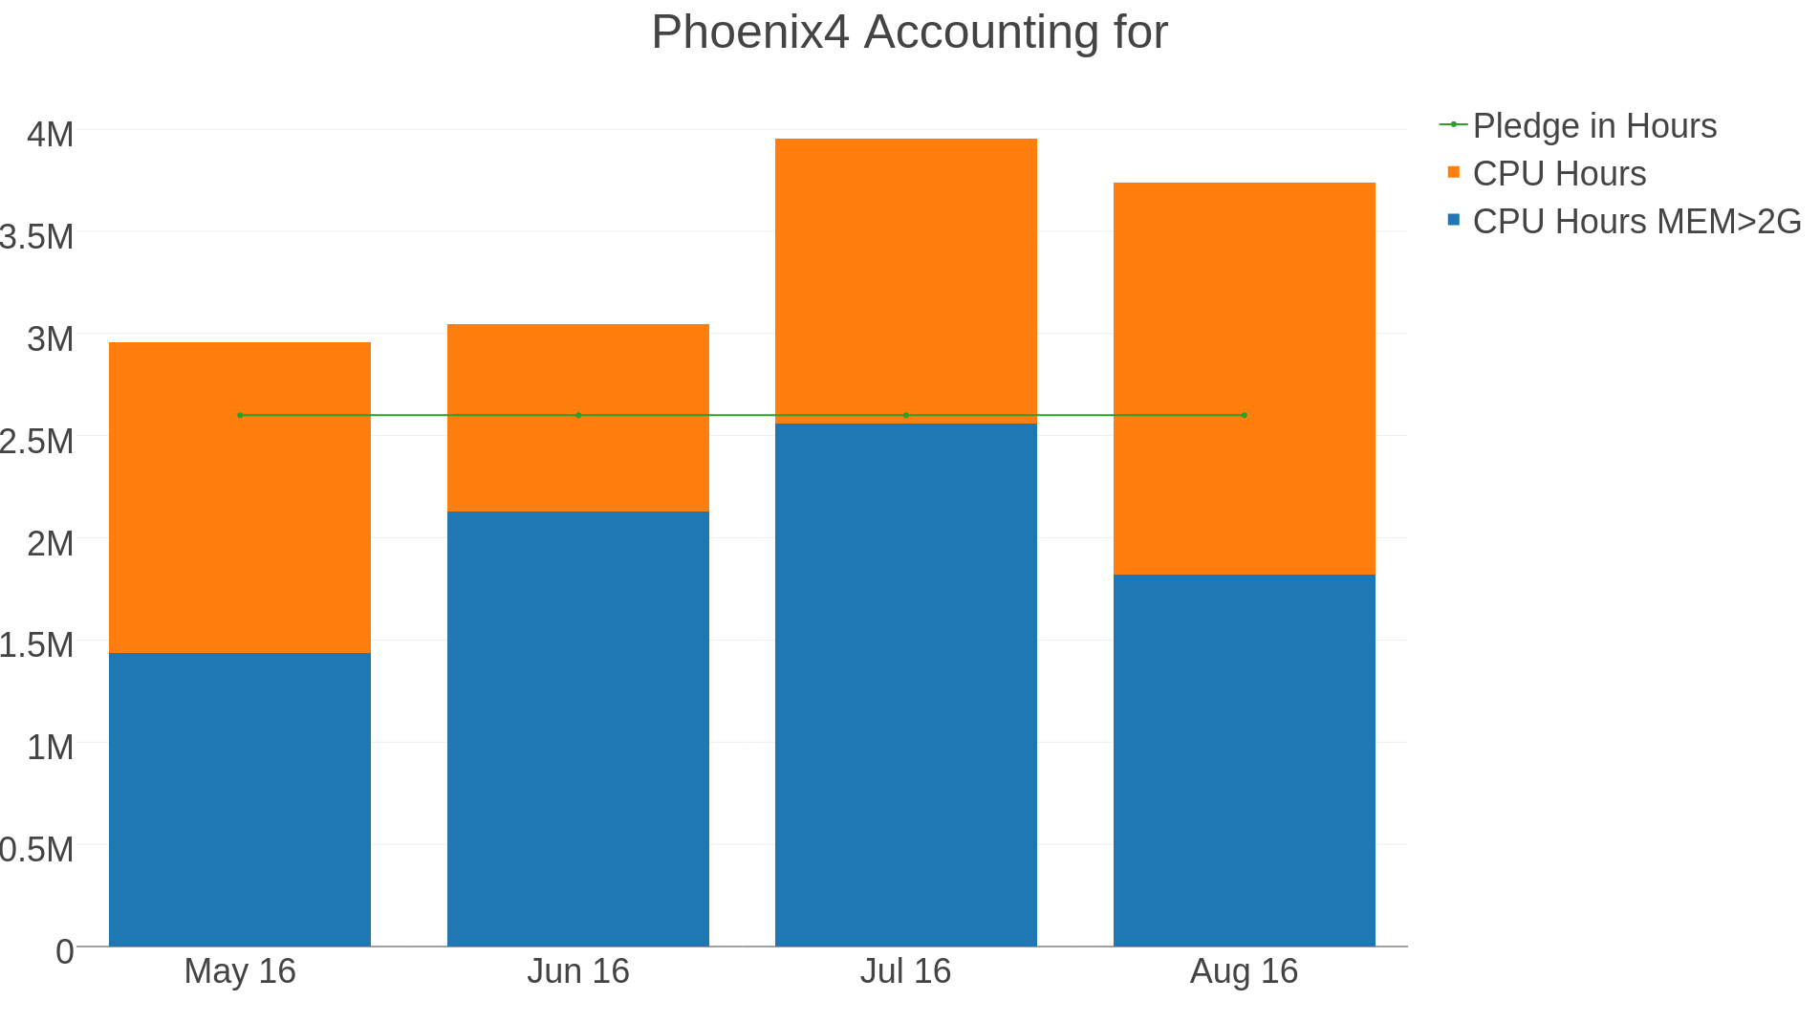
Memory Usage
If a job ask for more than 2.0G in ARC01/ARC03 does make sense that SLURM allocates 2 CPUs?

Slide 21
Support Changes
In order to improve the support CSCS is delivering we would like to propose:
Bi-weekly operations meetings (30’ phone call)
Common list of ALL open issues (tickets)
Discuss & re-prioritize (or even reject) requests based on priorities
Closer VO-Rep to CSCS relationship
Periodic 1-day visit on-site (Bern/PSI/anywhere) for CSCS to see the “world” through the VO-Rep’s eyes
Strengthen the understanding of each individual’s role. Develop ways to find problems sooner
Close the VO-Box discussion
Please send us your feedback!

Slide 22
Thank you for your attention.

