Slide 1
LHConCRAY
Acceptance Tests 2017 – Configuration overview
Miguel Gila, CSCS
October 03, 2017

Slide 2
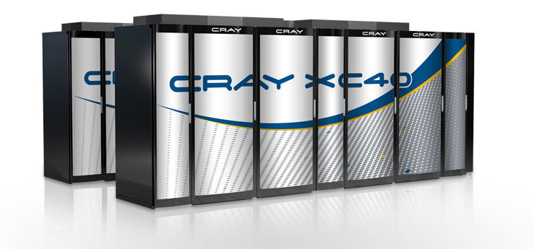
Run1. Setup the environment
CVMFS
XFS within GPFS
No SWAP
64 core/node
Memory is a consumable resource
CVMFS using XFS disks on scratch
Scratch on GPFS via DVS
XFS
GPFS
Piz Daint
DVS
CN
CN
CN
CN
CN
Internet
PHOENIX
DVS
CN
CN
CN
CN
CN
DVS
CN
CN
CN
CN
CN
GPFS
scratch
DVS
CN
CN
CN
CN
CN
DVS
CN
CN
CN
CN
CN
GW
PHOENIX
SLURM
CVMFS squid
dCache
arc04
GW
CVMFS squid
GW
arc05
VO Boxes
ARGUS
BDII
VO Boxes
BDII
GW
BDII
arcds1
GW

Slide 3
Run2. Test it
CVMFS
XFS within GPFS
No SWAP
64 core/node
Memory is a consumable resource
CVMFS using XFS disks on scratch
Scratch on GPFS via DVS
XFS
GPFS
Piz Daint
DVS
CN
CN
CN
CN
CN
Internet
PHOENIX
DVS
CN
CN
CN
CN
CN
DVS
CN
CN
CN
CN
CN
GPFS
scratch
DVS
CN
CN
CN
CN
CN
DVS
CN
CN
CN
CN
CN
GW
PHOENIX
SLURM
CVMFS squid
dCache
arc04
GW
CVMFS squid
GW
arc05
VO Boxes
ARGUS
BDII
VO Boxes
BDII
GW
BDII
arcds1
GW

Slide 4
Run3. Test it
CVMFS
XFS within DWS
No SWAP
64 core/node
Memory is a consumable resource
CVMFS using XFS disks on DWS
Scratch on GPFS via DVS
XFS
DWS
Piz Daint
DVS
CN
CN
CN
CN
CN
Internet
PHOENIX
DVS
CN
CN
CN
CN
CN
CVMFS preloaded (RO)
arc-cache (RO)
DVS
CN
CN
CN
CN
CN
GPFS
scratch
DVS
CN
CN
CN
CN
CN
DVS
CN
CN
CN
CN
CN
CVMFS
GW
PHOENIX
SLURM
CVMFS squid
dCache
arc04
DWS
GW
CVMFS squid
GW
arc05
VO Boxes
ARGUS
BDII
VO Boxes
BDII
DWS
DWS
DWS
DWS
GW
BDII
arcds1
GW
SSD
SSD
SSD
SSD

Slide 5
Run4. Lots of changes
CVMFS
Upper layer
64 GB of SWAP using DWS
64 core/node
Memory limits set to 6000MB/core, but memory is not a consumable resource, only cores.
CVMFS tiered cache: upper layer 6GB in RAM, lower layer preloaded on GPFS
Scratch on GPFS via DVS
Lower layer
GPFS
Piz Daint
DVS
CN
CN
CN
CN
CN
swap
swap
swap
swap
swap
Internet
PHOENIX
DVS
CN
CN
CN
CN
CN
CVMFS preloaded (RO)
arc-cache (RO)
DVS
swap
swap
swap
swap
swap
CN
CN
CN
CN
CN
GPFS
scratch
DVS
swap
swap
swap
swap
swap
CN
CN
CN
CN
CN
DVS
swap
swap
swap
swap
swap
CN
CN
CN
CN
CN
swap
swap
swap
swap
swap
Swap iSCSI targets
GW
PHOENIX
SLURM
CVMFS squid
dCache
arc04
DWS
GW
CVMFS squid
GW
arc05
VO Boxes
ARGUS
BDII
VO Boxes
BDII
DWS
DWS
DWS
DWS
GW
BDII
arcds1
GW
SSD
SSD
SSD
SSD

Slide 6
Run5. Test those changes
CVMFS
Upper layer
64 GB of SWAP using DWS
64 core/node
Memory limits set to 6000MB/core, but memory is not a consumable resource, only cores.
CVMFS tiered cache: upper layer 6GB in RAM, lower layer preloaded on GPFS
Scratch on GPFS via DVS
Lower layer
GPFS
Piz Daint
DVS
CN
CN
CN
CN
CN
swap
swap
swap
swap
swap
Internet
PHOENIX
DVS
CN
CN
CN
CN
CN
CVMFS preloaded (RO)
arc-cache (RO)
DVS
swap
swap
swap
swap
swap
CN
CN
CN
CN
CN
GPFS
scratch
DVS
swap
swap
swap
swap
swap
CN
CN
CN
CN
CN
DVS
swap
swap
swap
swap
swap
CN
CN
CN
CN
CN
swap
swap
swap
swap
swap
Swap iSCSI targets
GW
PHOENIX
SLURM
CVMFS squid
dCache
arc04
DWS
GW
CVMFS squid
GW
arc05
VO Boxes
ARGUS
BDII
VO Boxes
BDII
DWS
DWS
DWS
DWS
GW
BDII
arcds1
GW
SSD
SSD
SSD
SSD

Slide 7
Run6. Try Datawarp (and fail)
CVMFS
Upper layer
64 GB of SWAP using DWS
68 core/node
Memory limits set to 6000MB/core, but memory is not a consumable resource, only cores.
CVMFS tiered cache: upper layer 6GB in RAM, lower layer preloaded on GPFS
Scratch on GPFS via DVS (and DWS)
Lower layer
GPFS
Piz Daint
DVS
CN
CN
CN
CN
CN
swap
swap
swap
swap
swap
Internet
PHOENIX
DVS
CN
CN
CN
CN
CN
CVMFS preloaded (RO)
arc-cache (RO)
DVS
swap
swap
swap
swap
swap
CN
CN
CN
CN
CN
GPFS
scratch
DVS
swap
swap
swap
swap
swap
CN
CN
CN
CN
CN
DVS
swap
swap
swap
swap
swap
CN
CN
CN
CN
CN
swap
swap
swap
swap
swap
DWS
scratch
Swap iSCSI targets
GW
PHOENIX
SLURM
CVMFS squid
dCache
arc04
DWS
GW
CVMFS squid
GW
arc05
VO Boxes
ARGUS
BDII
VO Boxes
BDII
DWS
DWS
DWS
DWS
GW
BDII
arcds1
GW
SSD
SSD
SSD
SSD

Slide 8
Thank you for your attention.

