Slide 1
September CHIPP Review
Nicholas P. Cardo, CSCS
October 10, 2019

Slide 2
September Utilization
data recording issue
data recording issue
data recording issue
dCache
CVMFS
cautious reintegration of nodes
capacity
pledge
68 cores
64 cores
60 cores
maintenance
ARC hang
Atlas switches to Singularity
Singularity hang
Limits in progress of being available on dashboard

Slide 3
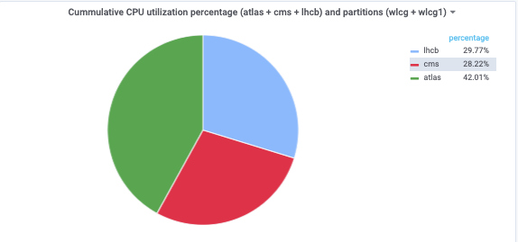
September Utilization Shares
Chart now available on dashboard

Slide 4
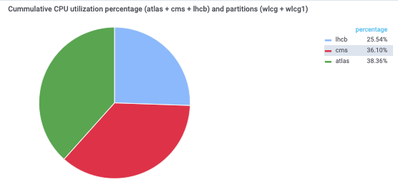
October Early Look

Slide 5
General Notes
Please avoid significant changes on Fridays
Daint Maintenance
Duration: 2 days
Target Window: November 4-6
Backup Window: November 25-27

Slide 6
Thank you for your attention.

