Slide 1
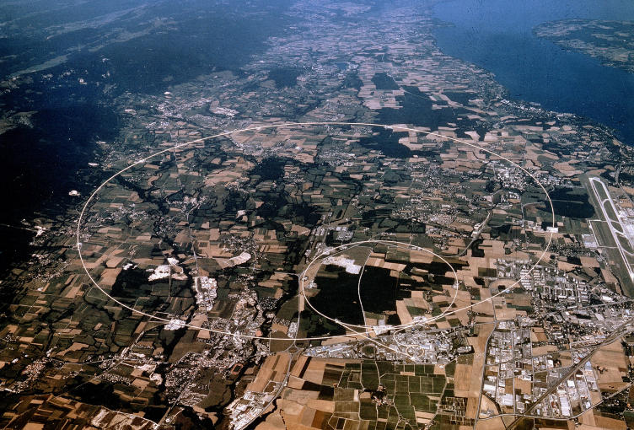
SWISS EFFORTS and CONTRIBUTIONS
  to the LHC and its EXPERIMENTS
  Allan Clark
  DPNC
  Université de Genève
  On behalf of CHIPP
The CSCS-CHIPP collaboration is an essential element
allowing analysis of LHC data by Swiss groups

Slide 2

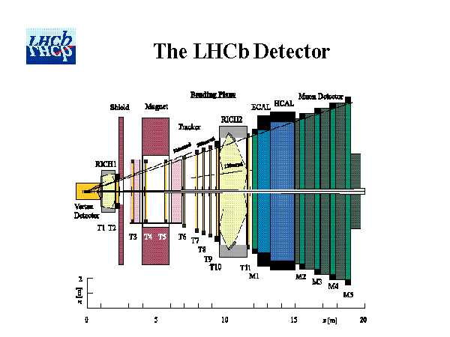
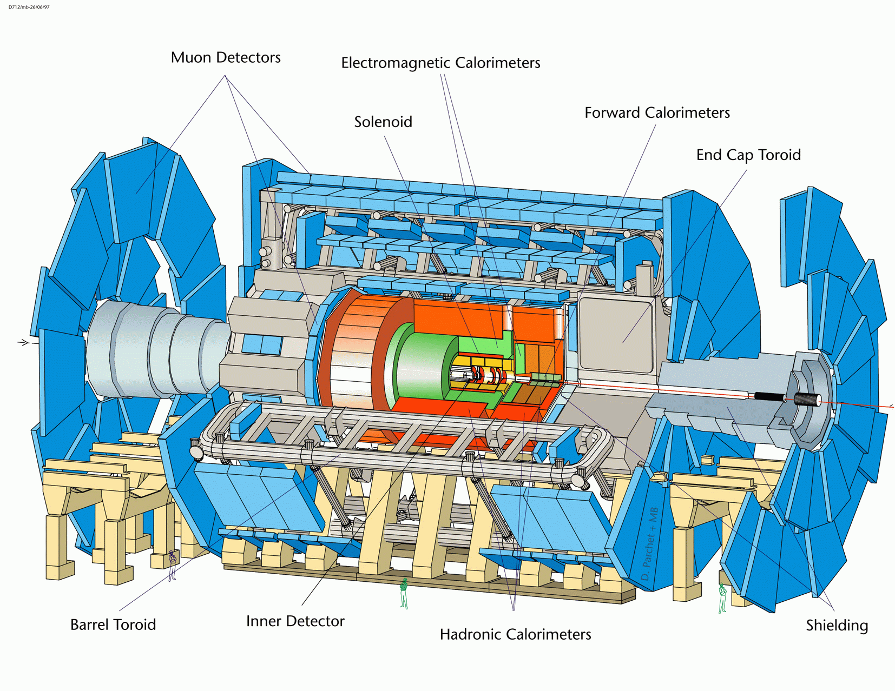
The LHC and Swiss Participation
CMS
LHCb
ATLAS
Large participation by Swiss institutes in machine and 3 of the LHC experiments
ATLAS, CMS and LHCb

Slide 3
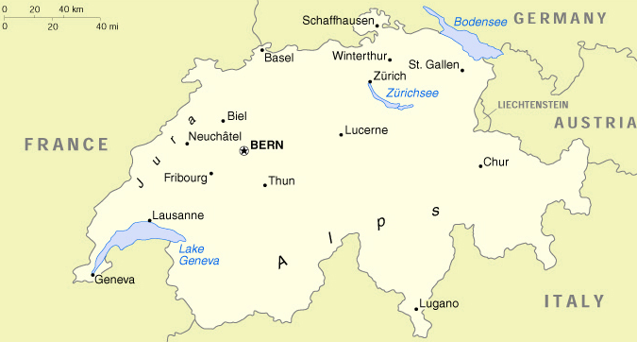

The LHC and Swiss Participation – support at federal and cantonal level
PSI
ETHZ
Zürich
Bern
EPFL
CERN
Geneva
CSCS Manno
ATLAS – Geneva, Bern
Other – CERN, CSCS Manno
CMS – ETHZ, PSI, Zürich
LHCb – EPFL, Zürich
Why
Manno?

Slide 4
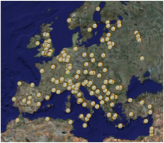
Why Manno?
Vast CPU and disk requirements for LHC experimental analysis beyond the scope of individual institutes – requires international collaboration on extended timescale
Particle physics implementation of GRID (LCG)
- Decision by CHIPP LHC institutes to
work together on computing issues
- Agreement with CSCS to provide
infrastructure in “T2+T3” framework

Slide 5
Switzerland as co-host to the CERN LHC
CERN is now the leading world accelerator laboratory
  LHC experiments will dominate particle physics research in
  next decade
  LHC experiments expect to collect first data (10 TeV) in Summer
  2008
  Tremendous opportunity for Swiss research groups (~350 physicists
  and doctoral students associated to CHIPP in Switzerland)
The benefits for Switzerland are scientific, cultural and economic
  Investment in contracts and services in Switzerland
  Technology transfer to industry and training
  Association with new technologies (e.g. GRID)
LHC machine and LHC experiments are strongly supported
  Federal, cantonal and institute level
  Financial, advisory and “in-kind” support
  This has enabled substantial contributions to both LHC and Swiss LHC groups
  Hopefully an effect on quality of research
  Support includes that of CSCS
Note some contributions to the LHC machine in addition to CH budget contribution to CERN
CH contribution to and status of the experiments
Analysis and computing in CH for LHC

Slide 6
Switzerland as co-host to the CERN LHC
Special financial contributions ( non-inclusive) related to
LHC
  25 MCHF (transfer tunnels)
  11 MCHF (indexation 1998-05)
  12 MCHF (LHC test beam at PSI) 12 MCHF
  14 MCHF (loan interest redemption)
  28 MCHF (infrastruction, upgrade, CLIC etc
Contracts (4.4% of 2936 MCHF total construction
machine)
  43 MCHF (magnet elements)
  19 MCHF (cryogenics)
  13 MCHF (accelerator components)
  55 MCHF (civil eng + exp. services)
Companies involved (non-inclusive)
  ABB Power Automation Casutto &Co
  Forbeton Bohr SA Leica SA
  MGC Ltd Huber & Suhner AG
  Zschokke SA Luwa SA
  Cicorel SA Cryogenic SA
  Kabelwerke Brugg EMPA
  Nexans (Cortaillod) …….
90 MCHF
Enormous
contributions
and
benefits
130 MCHF

Slide 7
The LHC experiments – contribution of Swiss Groups
Experiment | Institute | # physicists | # doctoral students | ~ # technical support | CORE¹ construction (MCHF)
CMS 38 countries 184 institutes | ETH Zürich PSI UniZh | 15 12 5 | 13 7** 4 | 22 3 2 | 92
ATLAS 37 countries 167 institutes | UniGe UniBe | 15 7 | 10 3 | 9 4 | 23
LHCb 15 countries 49 institutes | EPF Lausanne UniZh | 10 5 | 10 3 | 8 2 | 8
Total |  | 69 | 50 | 50 | 123
In addition :
  CUS has created a « CHIPP Priority Program for LHC Physics Analysis »
  with 10 post-doctoral positions in the period 2008-2012
  Rules of FNRS PRO*DOC program modified to be compatible with practical
  requirements of the LHC program.
  Request made to FNRS for ~10 doctoral positions.
  ¹ Federal and Cantonal funding – computing not included
  ** 5 students co-financed with ETHZ, 2 students co-financed with UniZh

Slide 8
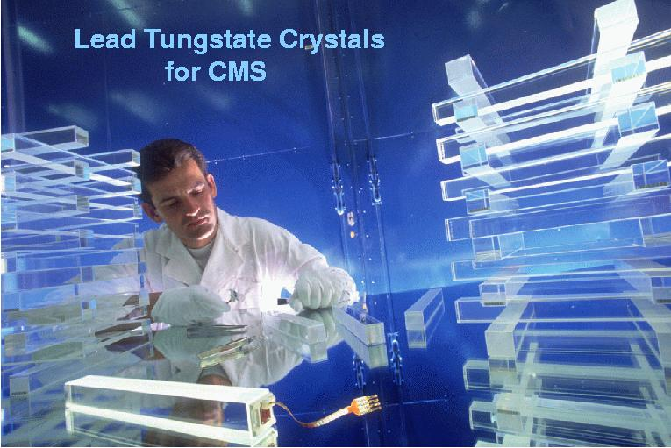
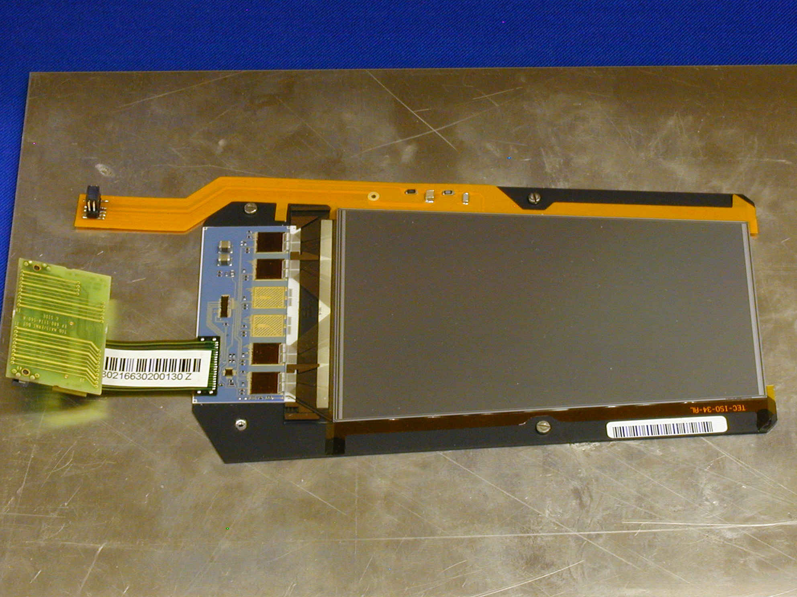
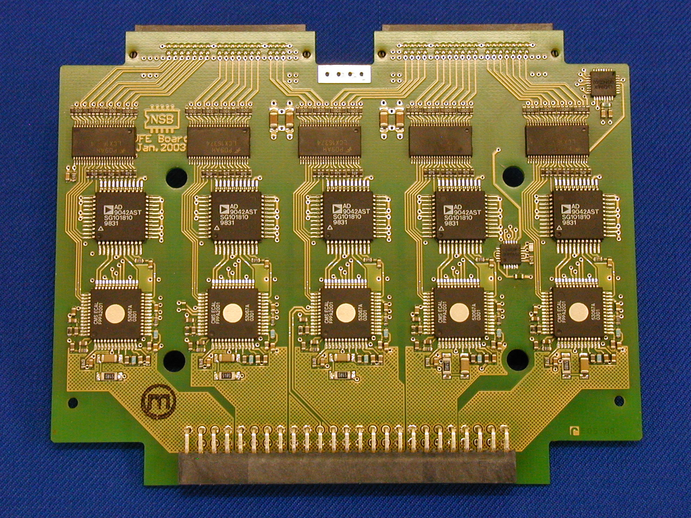
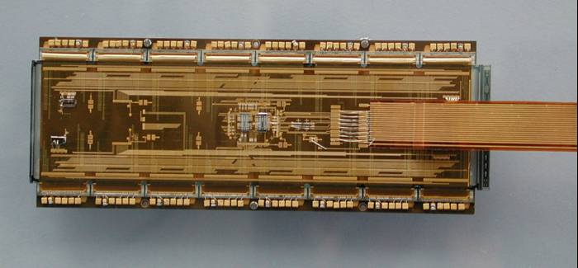
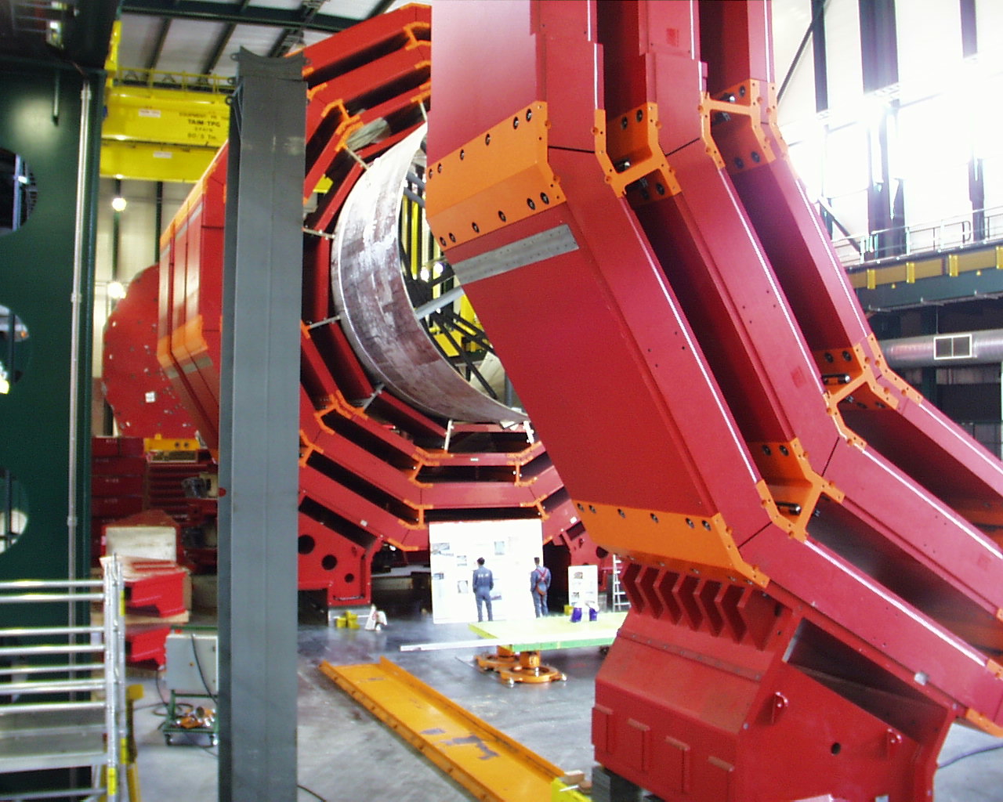
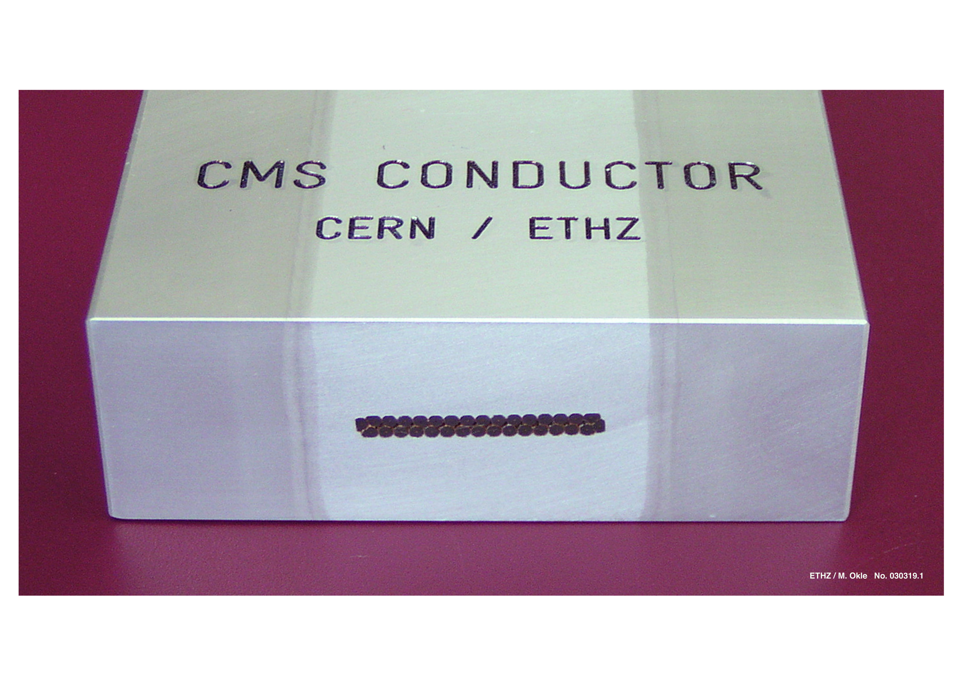
The LHC experiments – CMS
CMS Detector:
Weight: 12’500 t
Diameter: 15 m
Length: 21.6 m
Magnetic field: 4 T
Crystal calorimeter ETHZ
Electronics ETHZ, PSI
Silicon strips ETHZ
Superconductor
for magnet ETHZ
Pixel detector
PSI, ETHZ, UniZh
Software & Physics
Organization
of magnet
procurement
ETHZ
ETHZ, PSI, UniZh

Slide 9

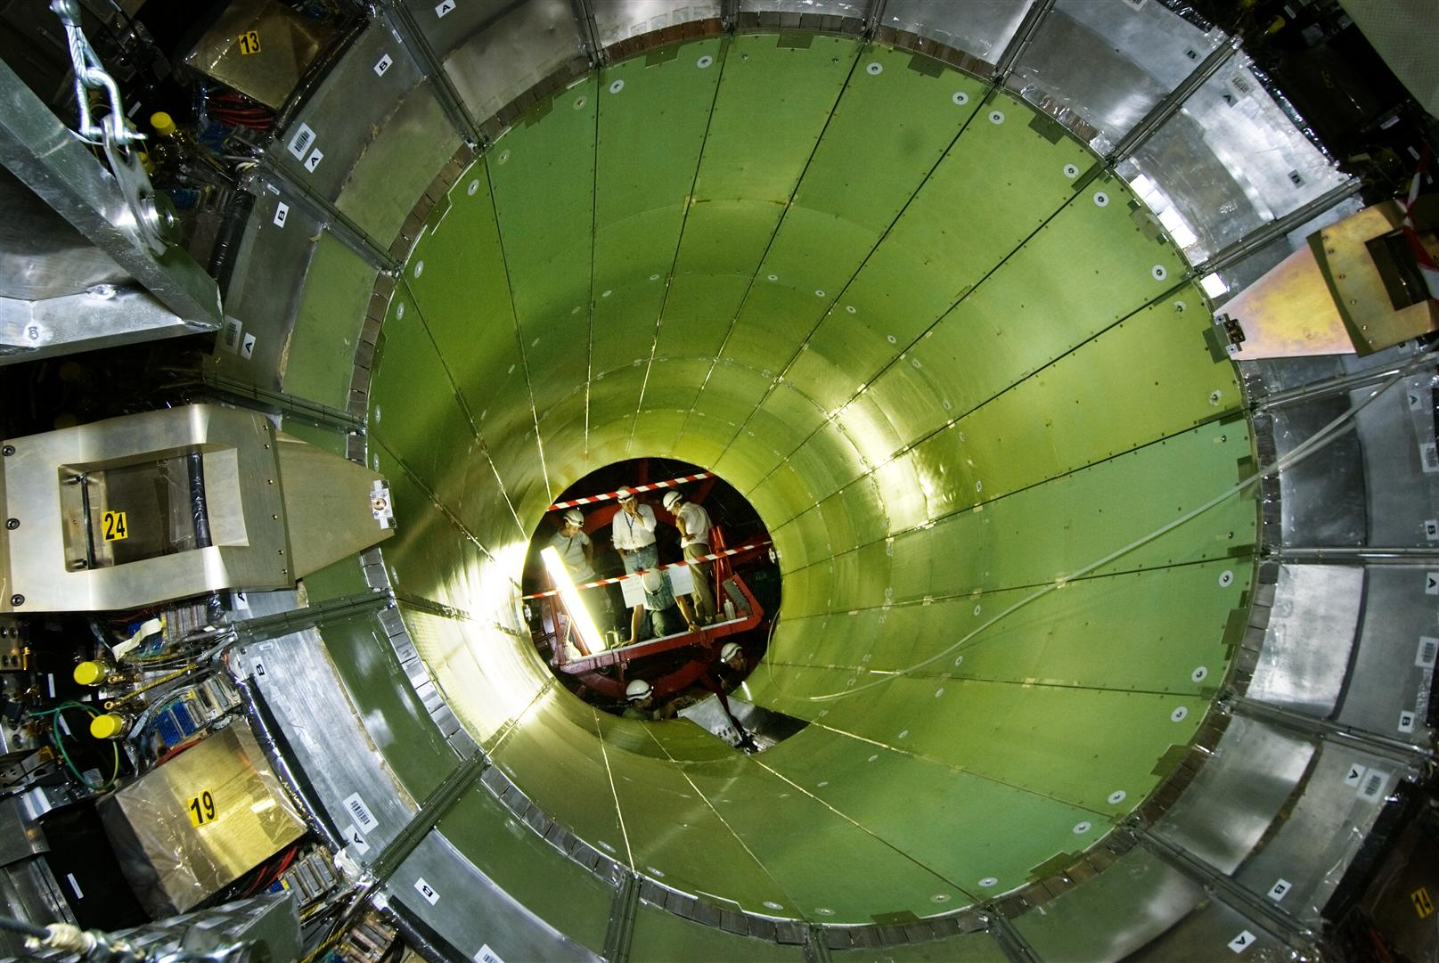
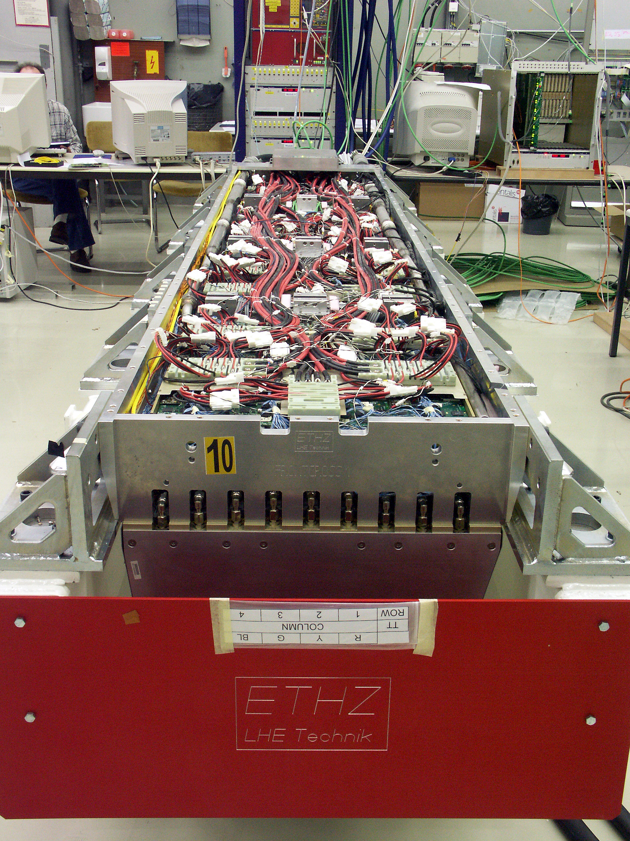
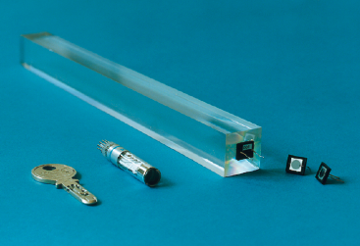
CMS – the Electromagnetic Calorimeter
ETH Zurich: crystal, electronics and electronics integration
PSI: Photo detector for barrel (APDs)
1 Supermodule:
1‘700 PbWO₄ crystals
Barrel:
61‘200 Crystals
36 Supermodules
installation terminated on July 27, 2007
Lead Tungstate crystals (PbWO₄)
Front face. 2.2x2.2cm² , Length 23 cm
ETH integration center at CERN
APD

Slide 10
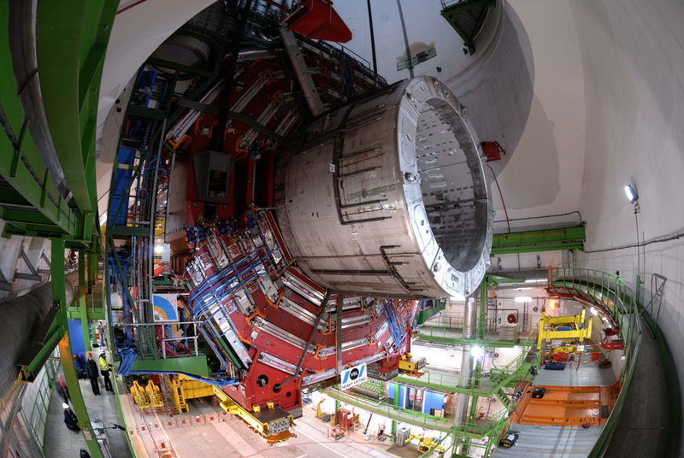
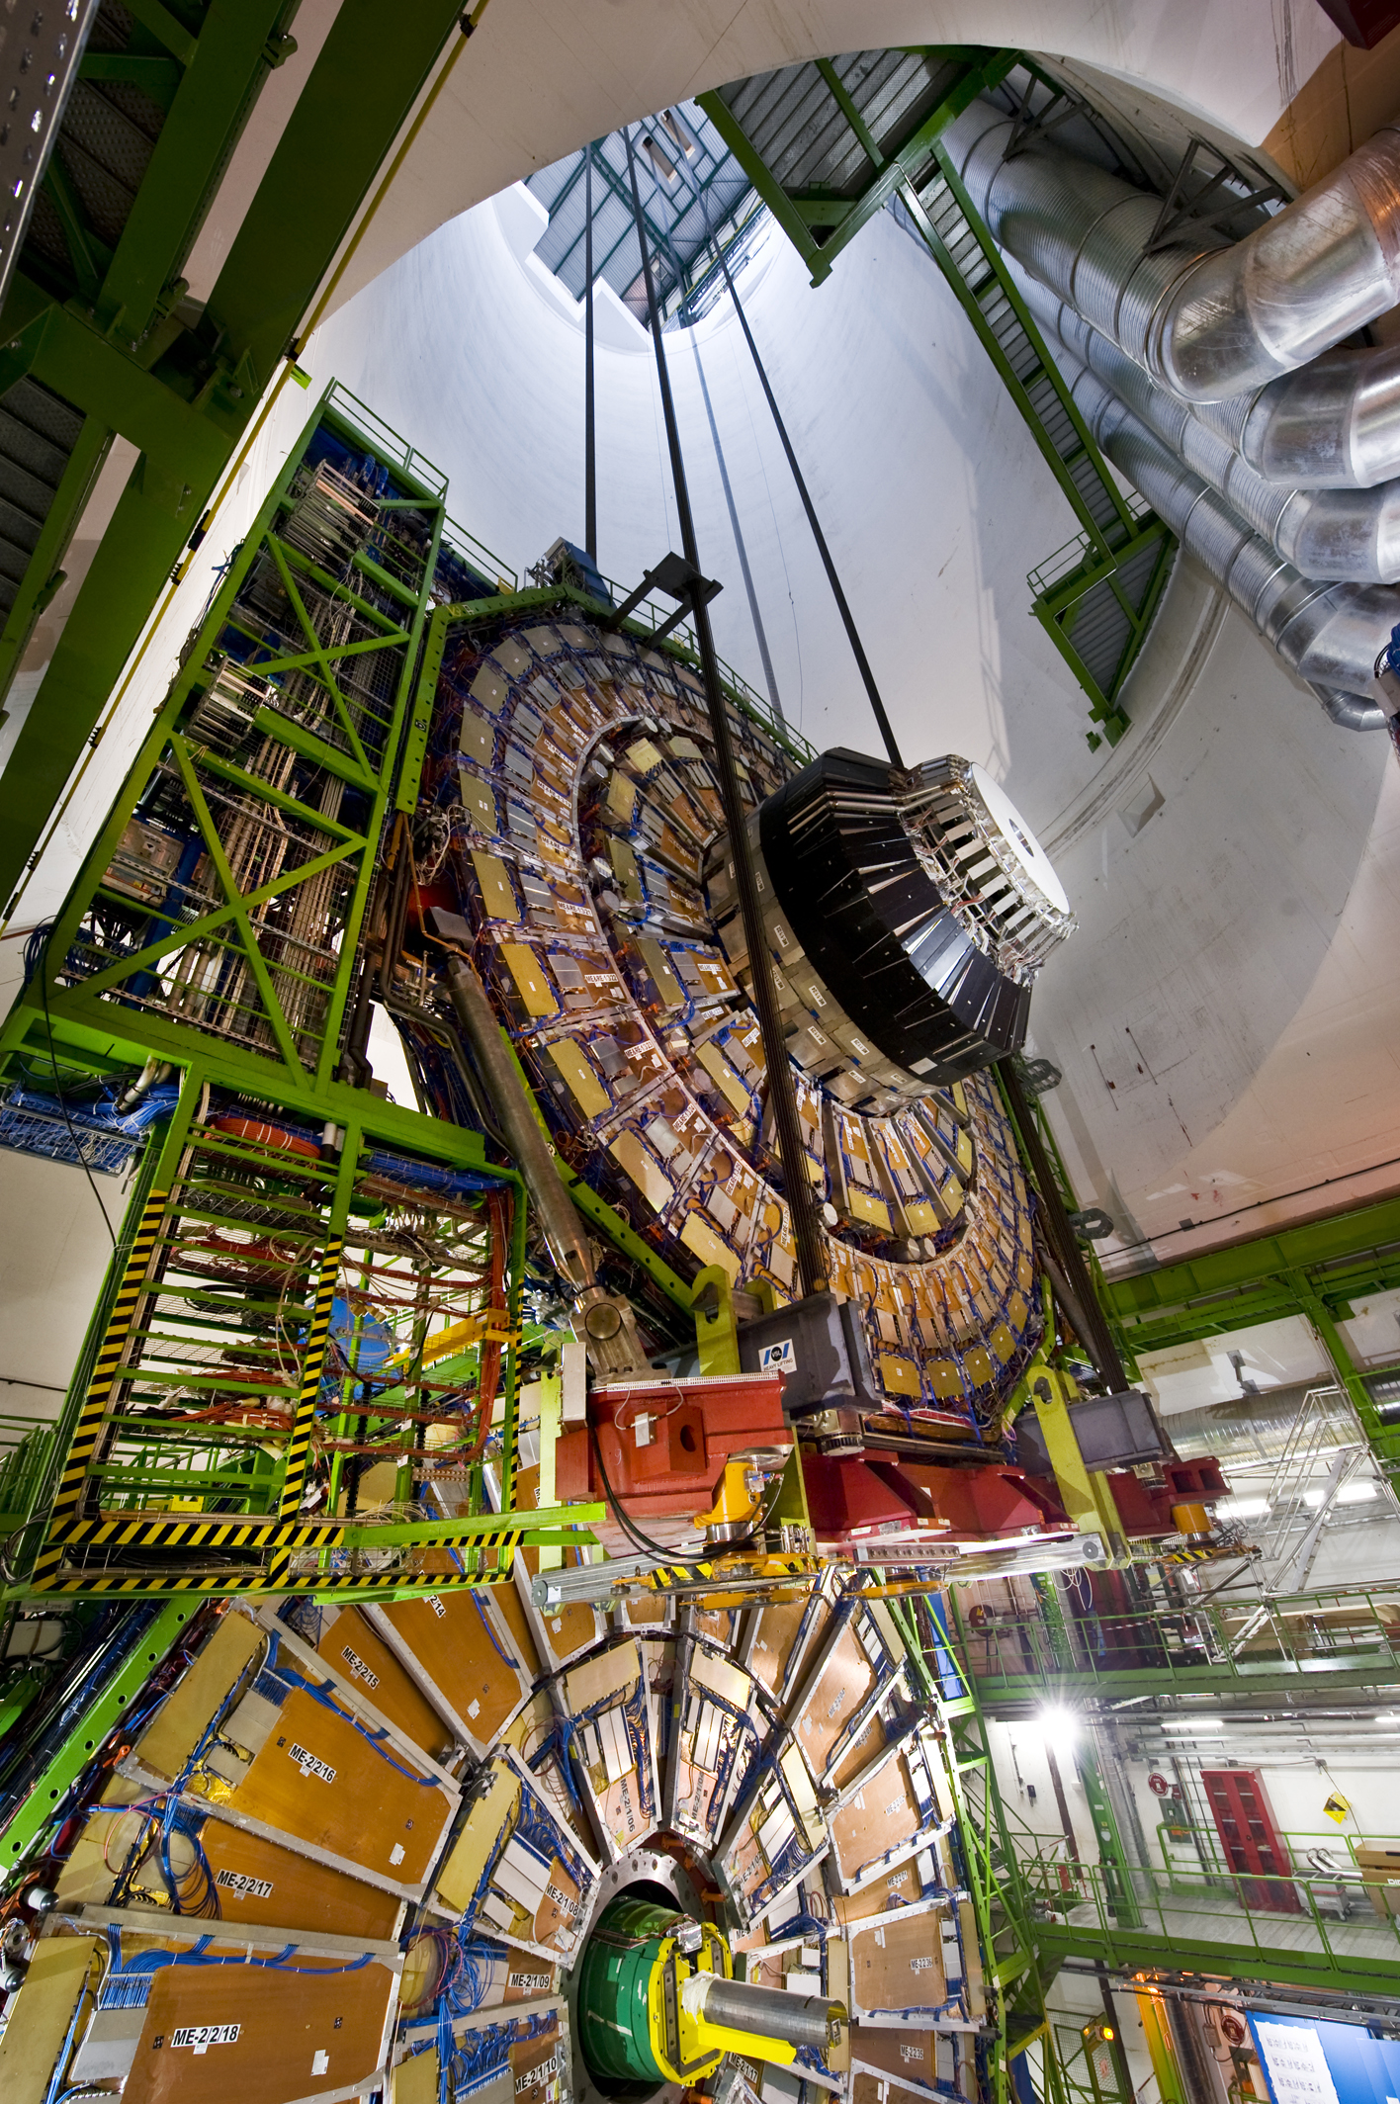
CMS – Lowering magnets into the cavern
Lowering of central and heaviest element (~ 2000 t) on February 28, 2007
Central part including magnet (2000 tons)
(as heavy as 5 Jumbo jets)
Cool-down and mapping of the 4Tesla magnet completed
Last element lowered on 22 Jan 2008.

Slide 11
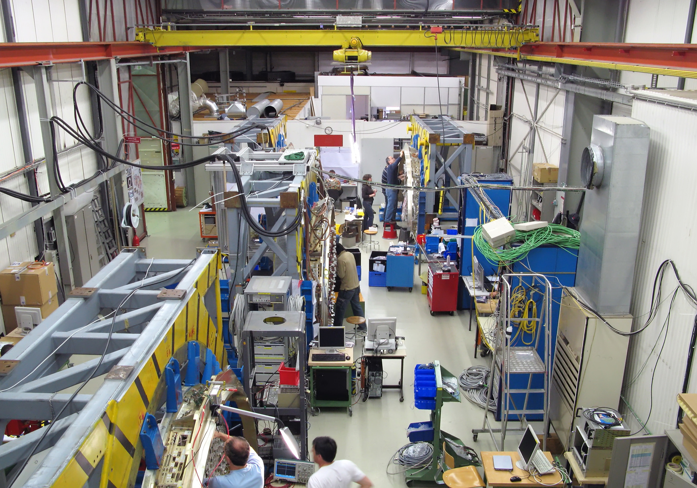
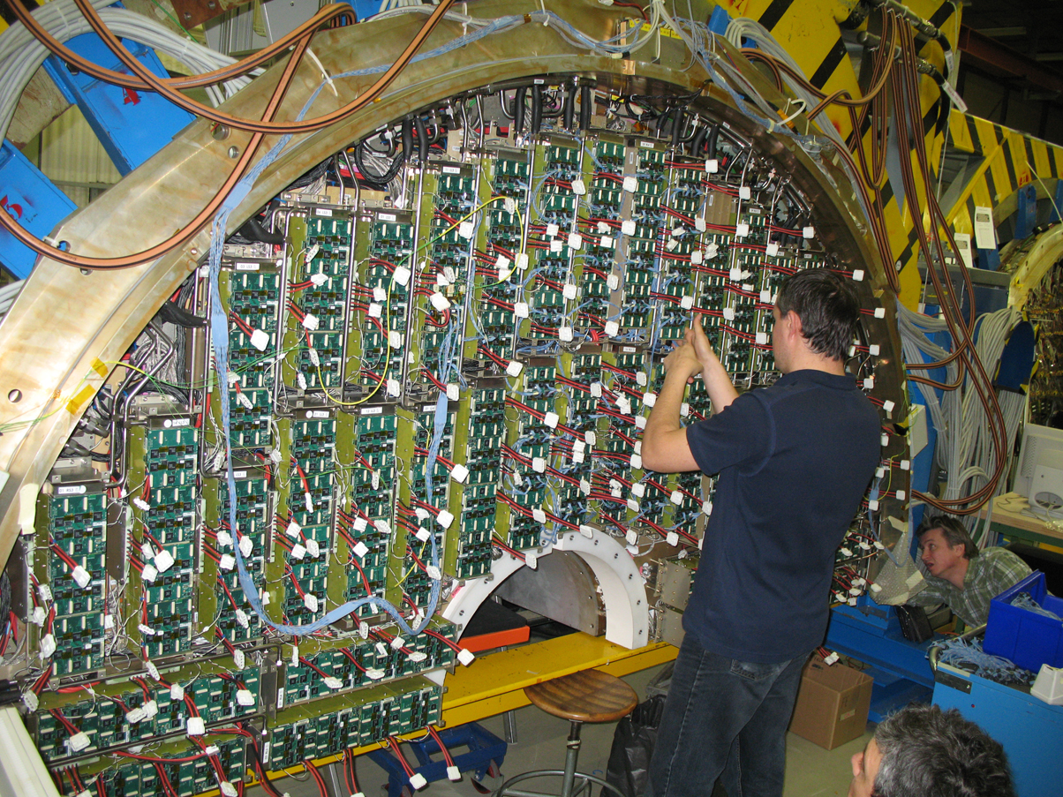
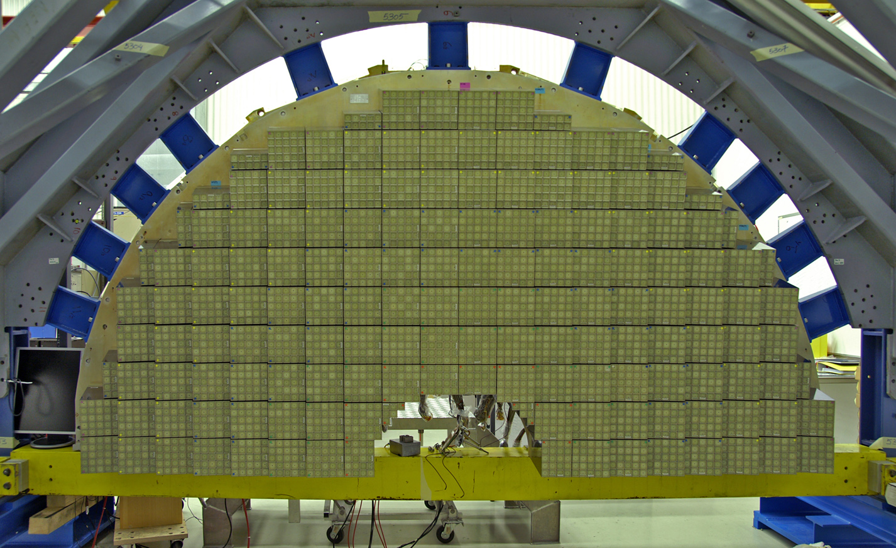
CMS – ECAL Endcap Construction
ETH Electronics Integration Center (bld 867):
1st EE ready for installation by mid-June.
Last EE Dee scheduled for week 30.
Dee 1
Dee 3

Slide 12
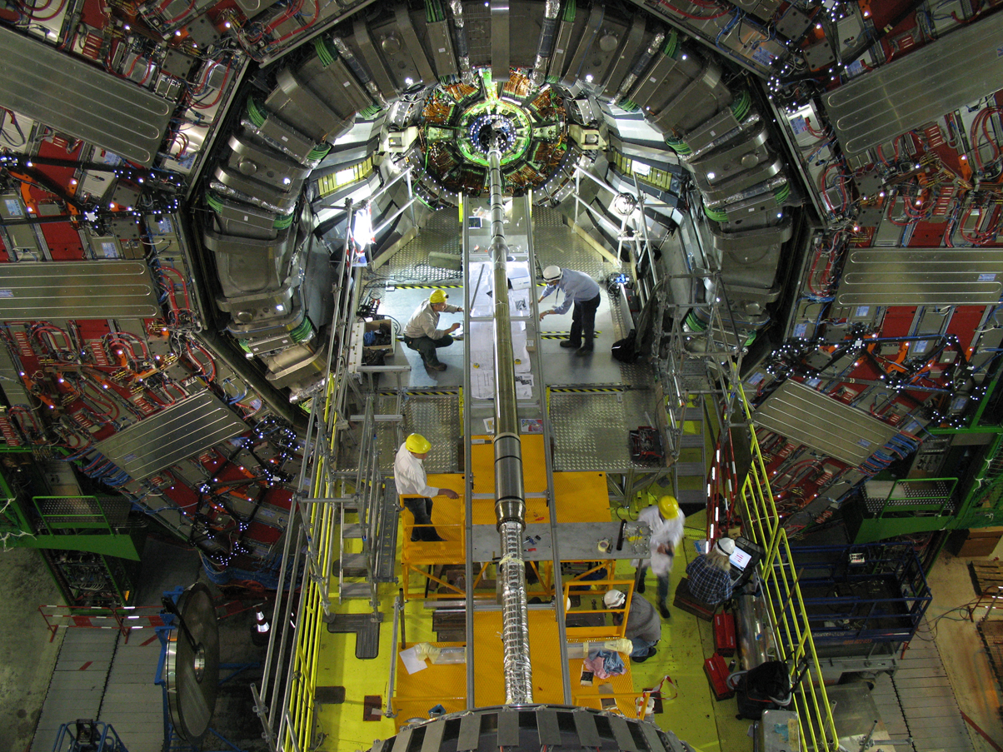
CMS – Endcap beam pipe installation
Endcap beam pipe:
installed on 30 April.
Leak tested 1May

Slide 13
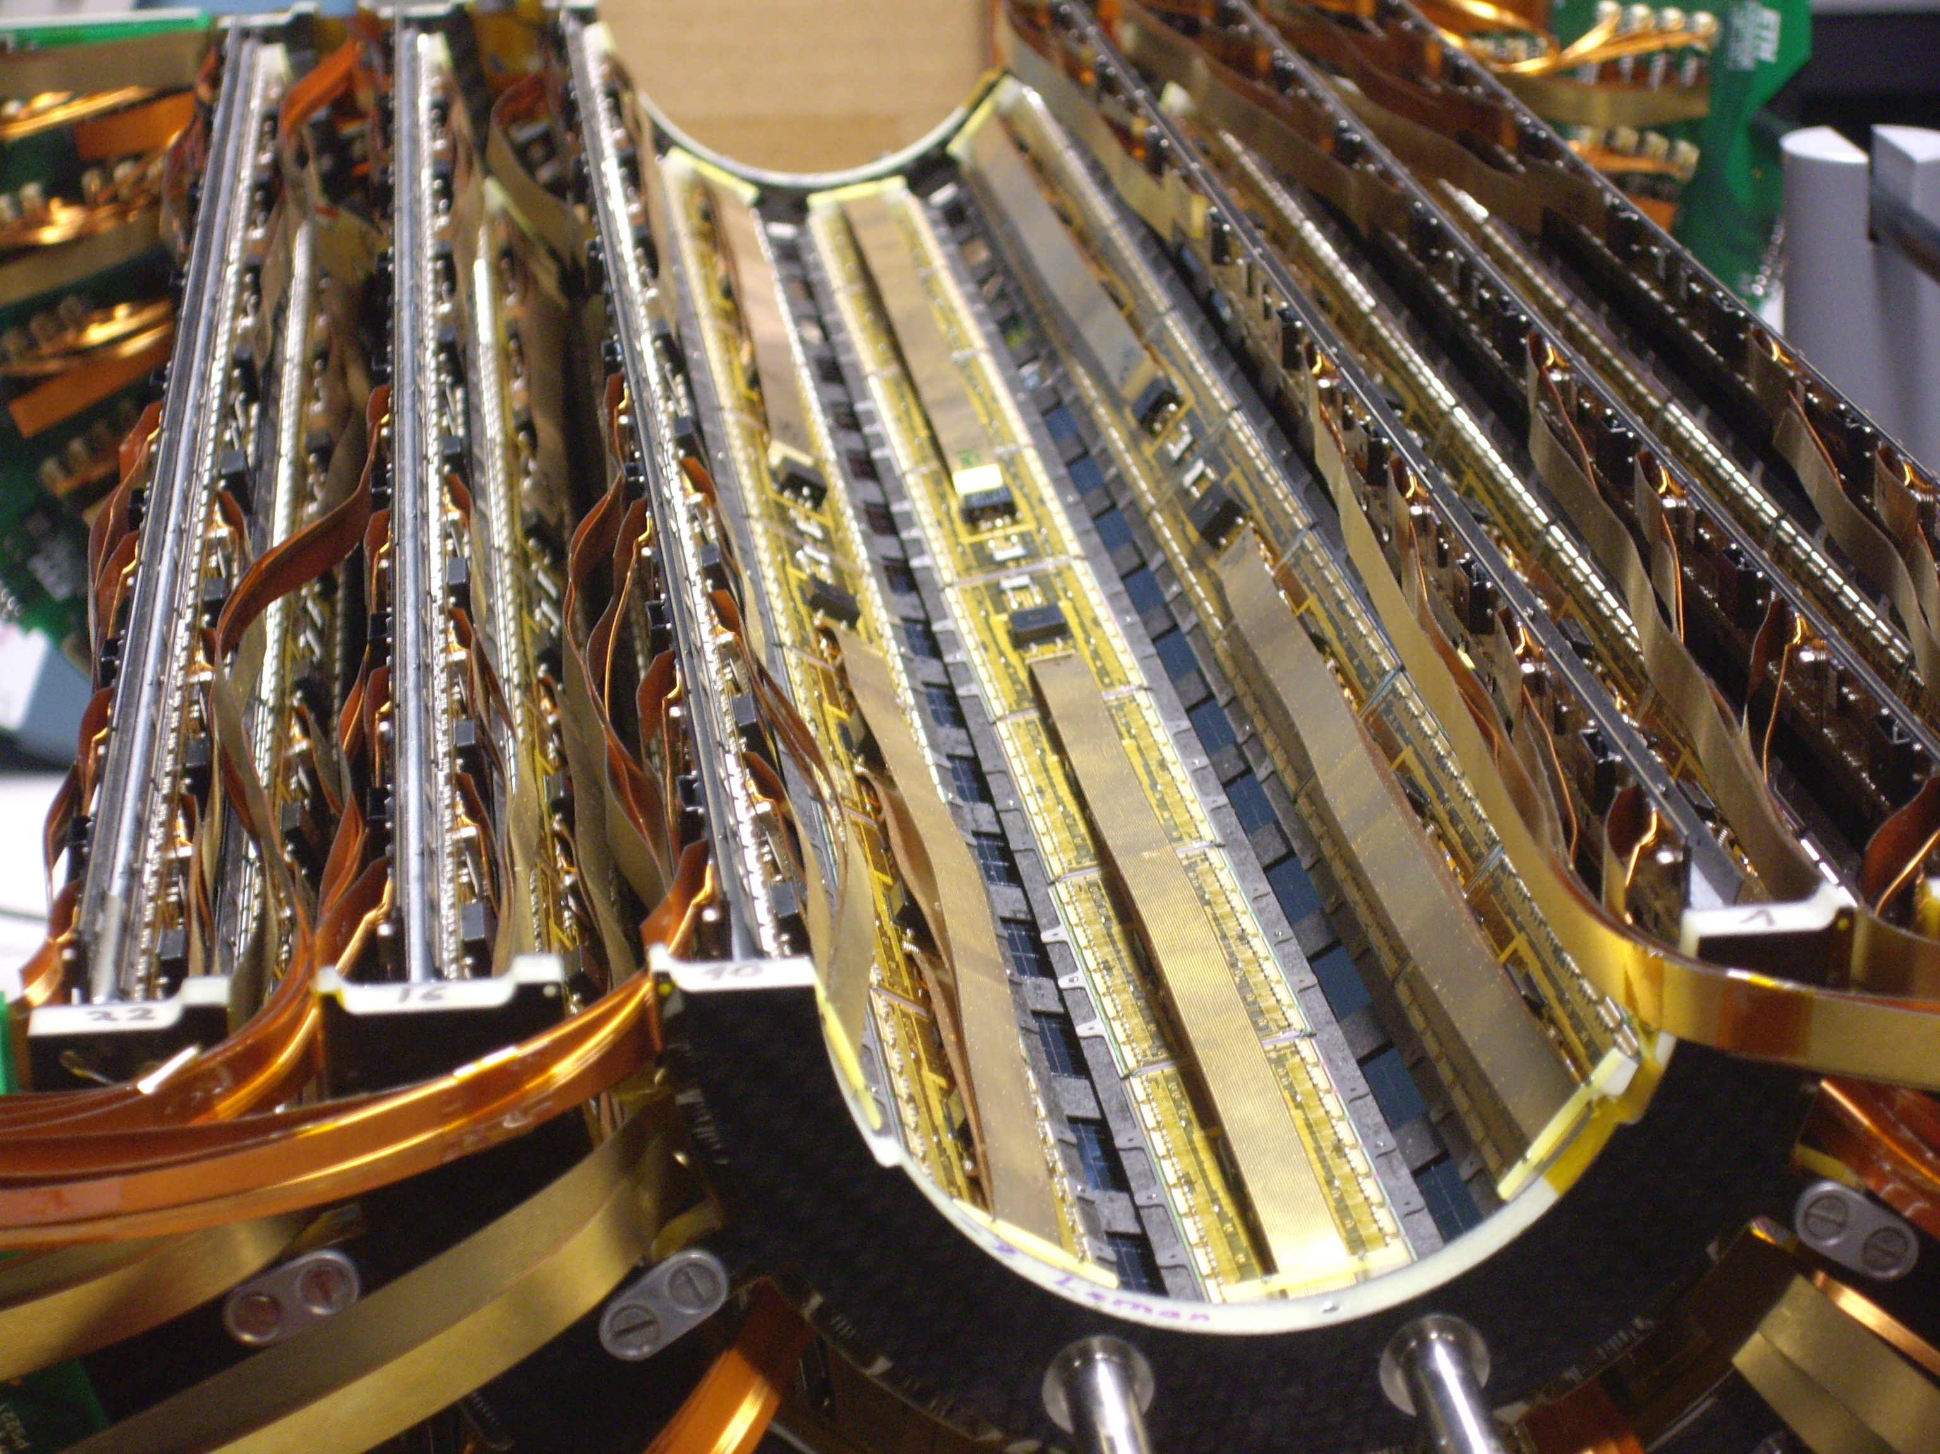
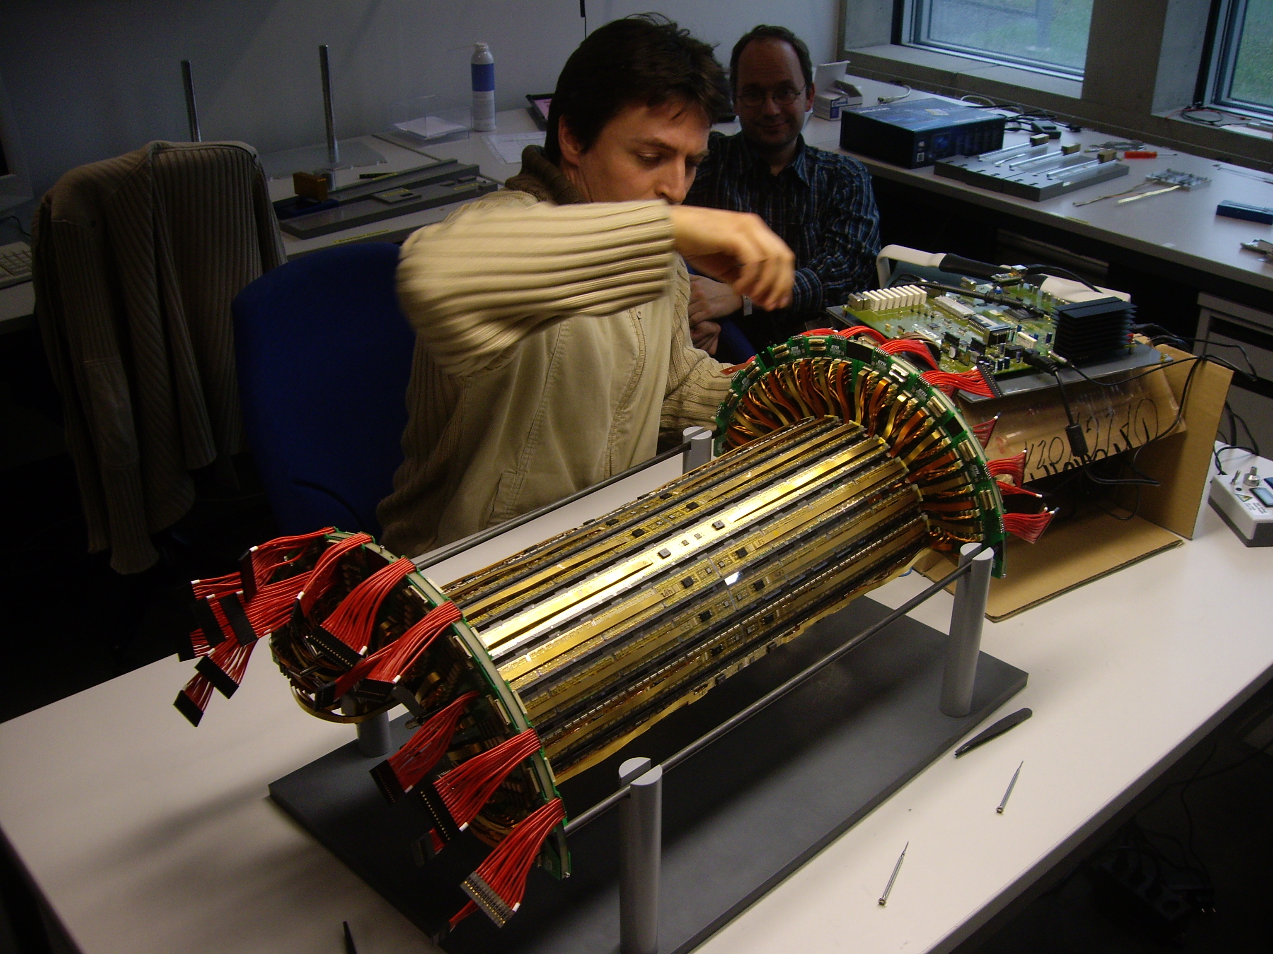
CMS – Barrel Pixel Mechanics and Assembly
Collaboration UniZh and PSI
Silicon pixel detector close to the beam interaction region
Mechanics and assembly completed 12 March 2008
Emphasis in CH contributions on silicon-based tracking detectors

Slide 14
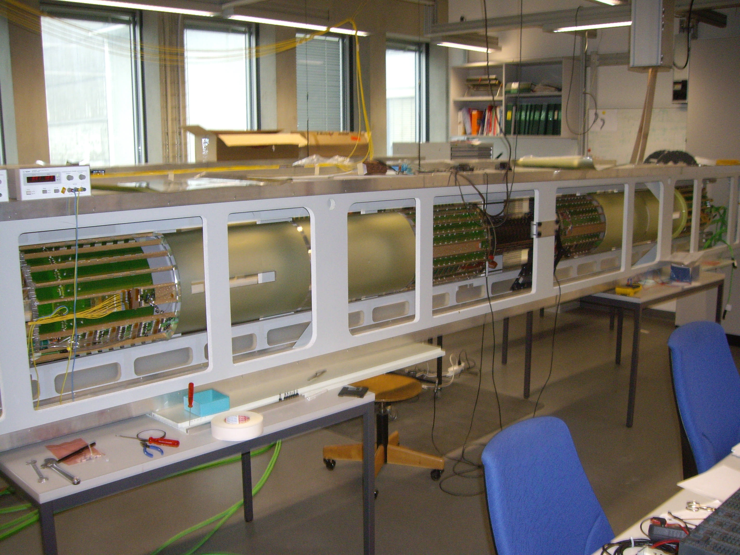
CMS – Pixel Detector
Pixel detector at PSI May 2008
  Fully assembled after the supply tube and the services added
  Installation time of ~1 week prior to beam closure
  Installation of mockup detector into CMS made
  In parallel development of DAQ, DCS etc ongoing

Slide 15
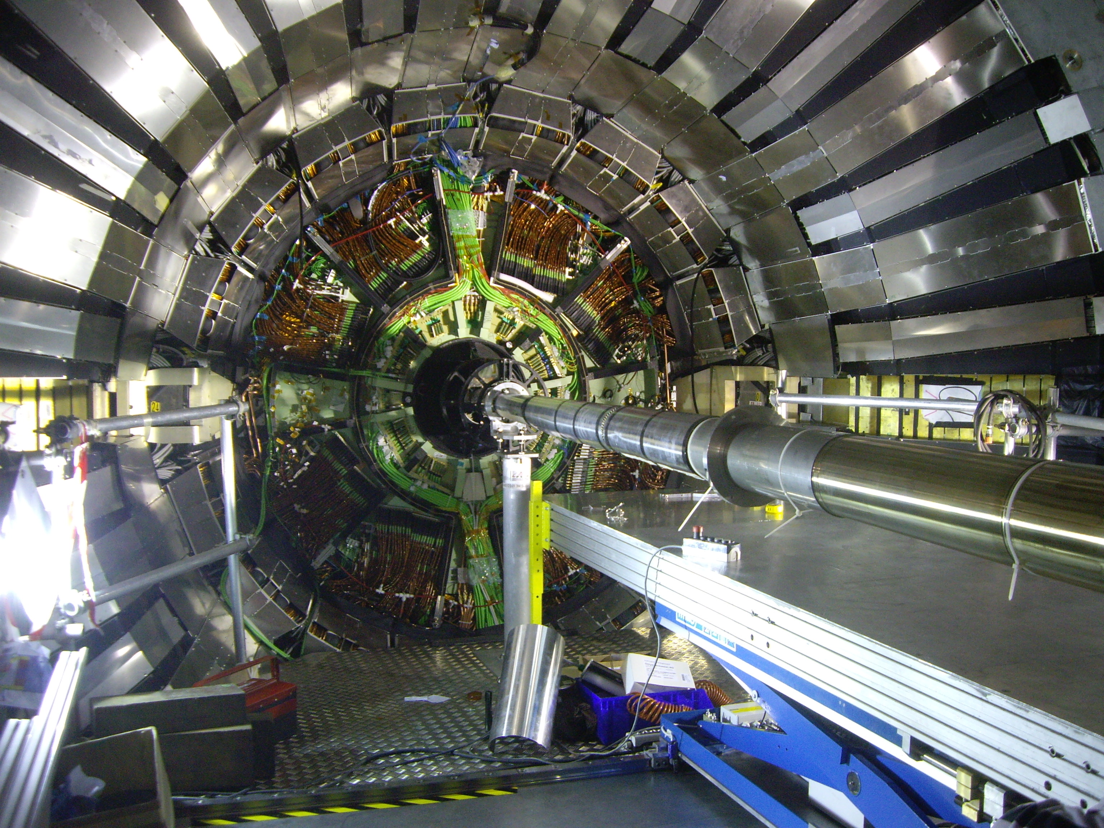
Close up of PP0, beam pipe & installation table
CMS – Barrel Pixels
Close-up of PP0, beam pipe and installation table during mockup
installation procedure for the barrel pixels.

Slide 16

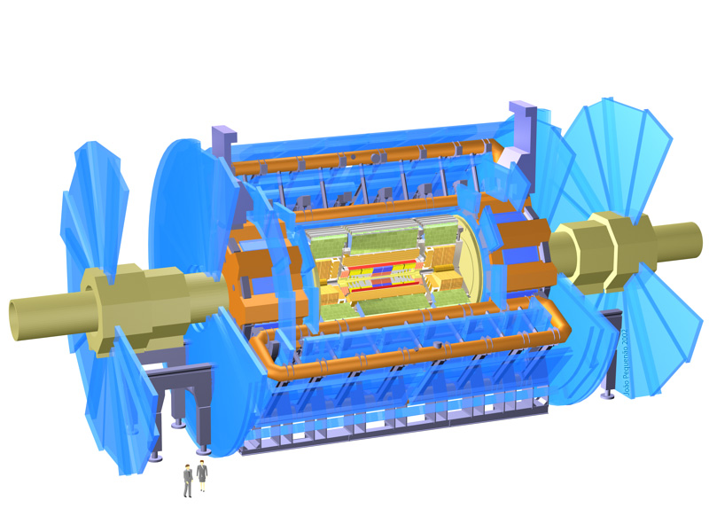
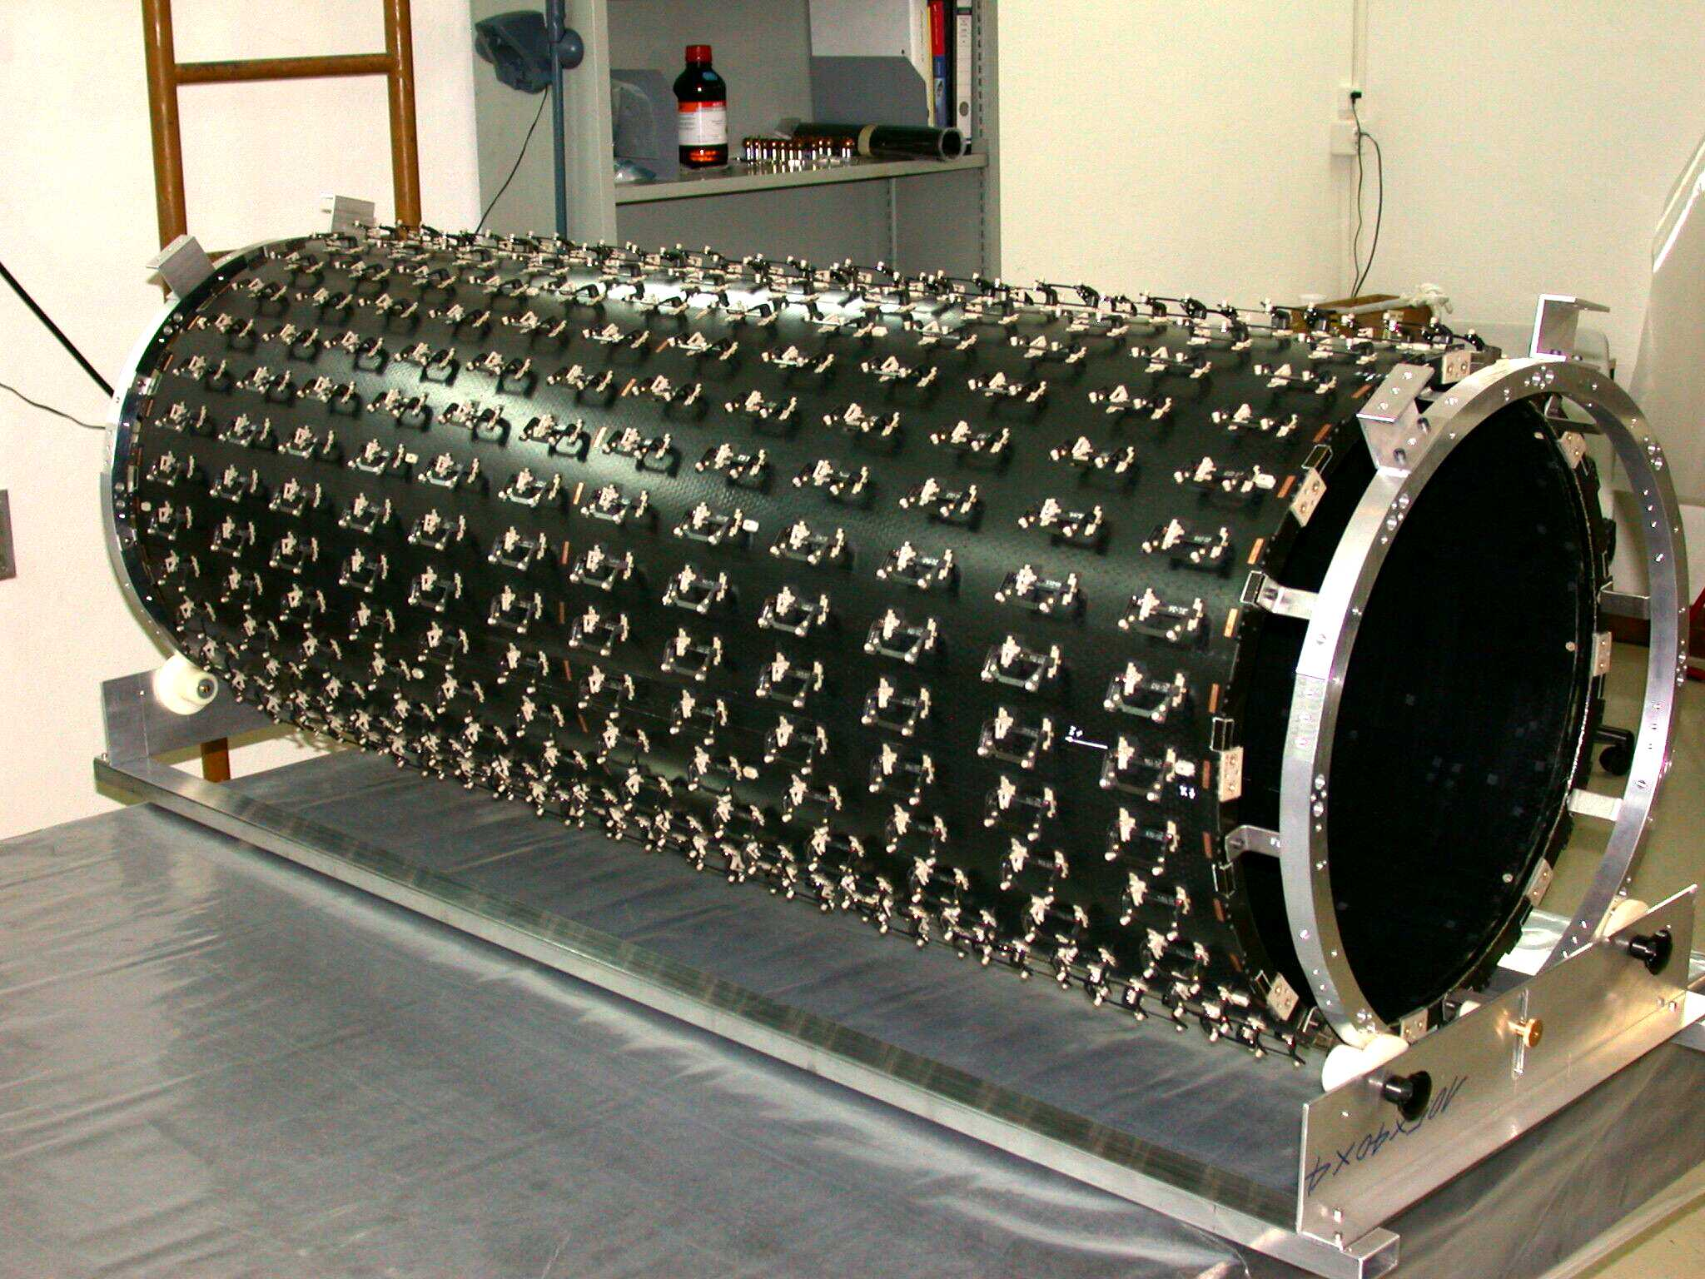
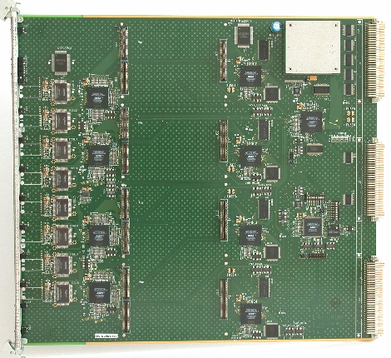
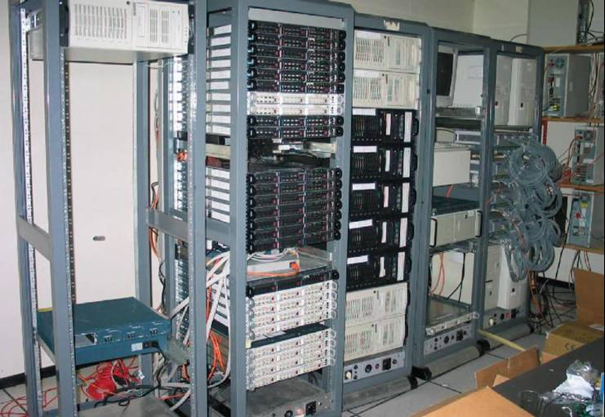
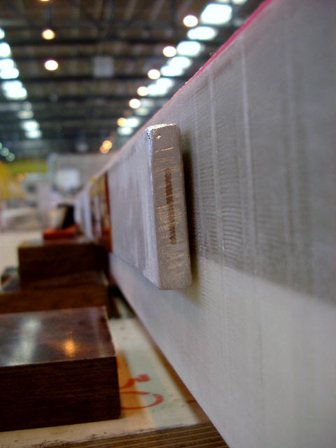
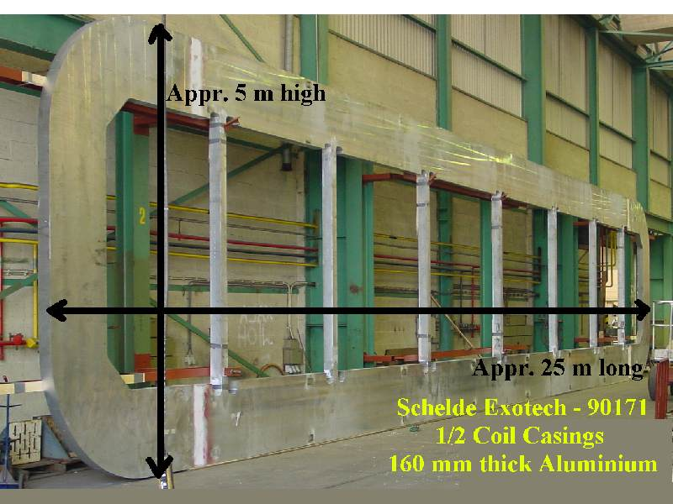
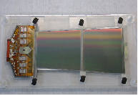
The LHC experiments – ATLAS
The ATLAS Detector
Weight: 7000 tons
Dimensions: 46m x 22m x 22m
Magnetic Field: 2.6 T (solenoid) and 4.1 T (toroid)
Semiconductor Tracker Geneva
Tracker Support Structure
Geneva
Readout Electronics (ROD) for Calorimeters
Geneva
TDAQ- Trigger and Dataflow
Bern and Geneva
Physics and Computing
Preparations
Online and Offline Software
Bern and Geneva
Superconductor and Casings for Barrel Toroid Coil
Bern and Geneva

Slide 17
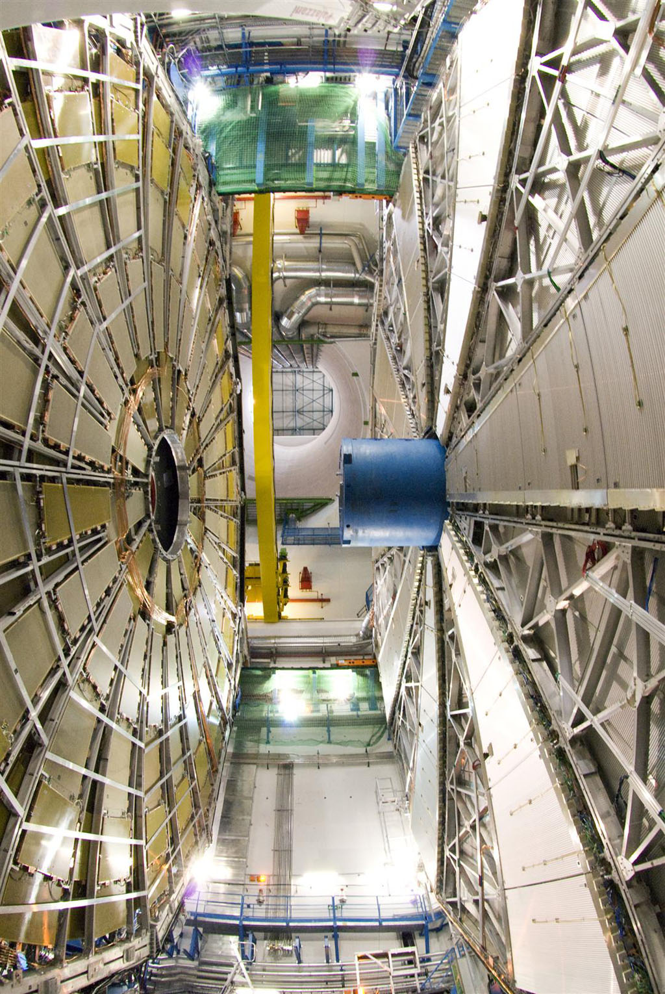
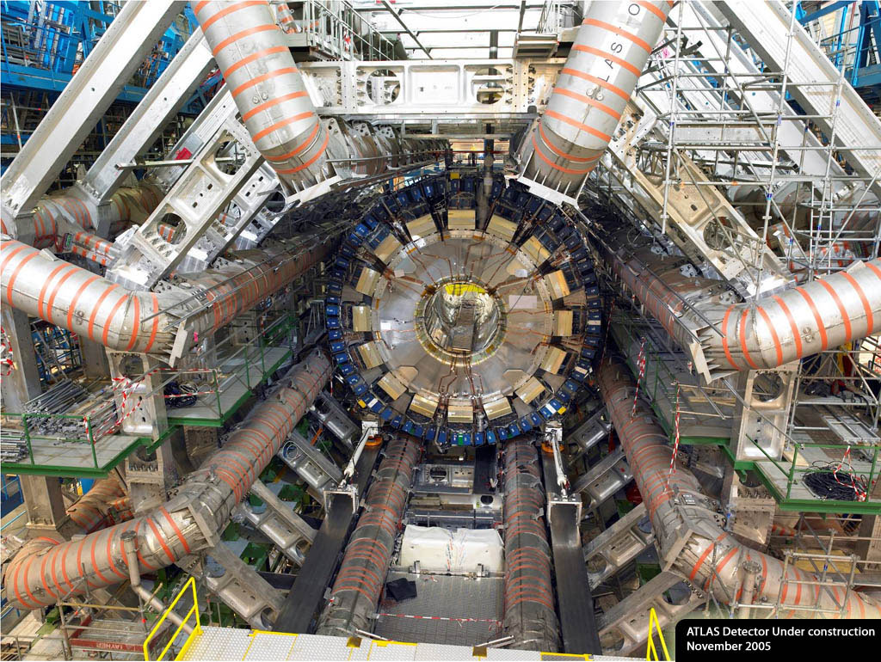

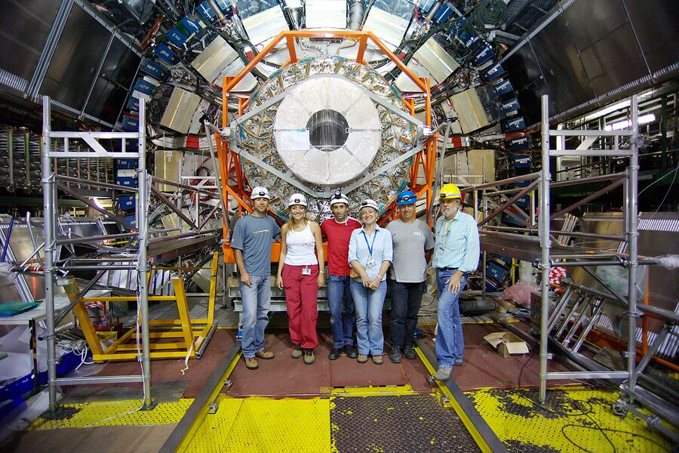

The LHC experiments – ATLAS integration
barrel toroid and calorimeters
1996
coil casings and
superconductor
2001
SCT and TRT barrel
2003
big TGC and MDT muon wheels
support structure
and engineering
MDT=Monitored Drift Tubes
TGC=Thin Gap Chambers

Slide 18
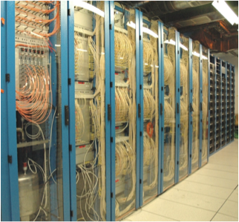
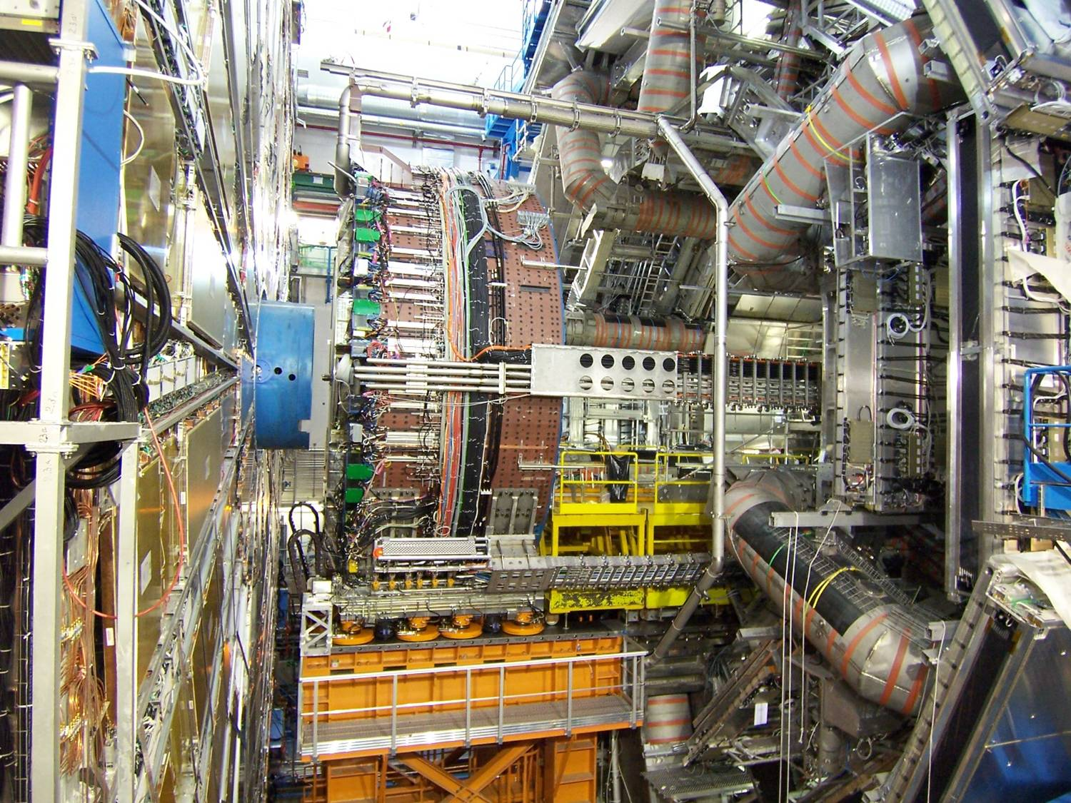
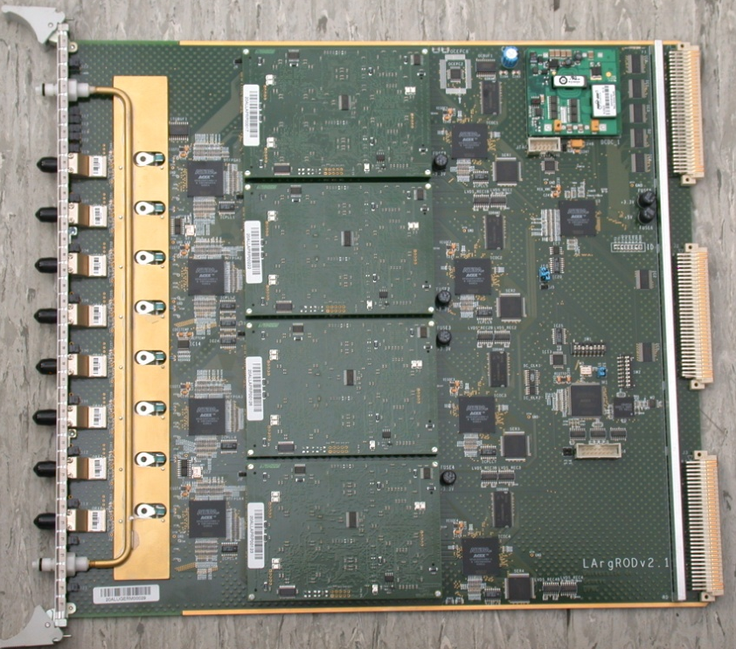
The LHC experiments – ATLAS Liquid Argon calorimeter
All 3 cryostats cold
Temperature stable in time, mean <20 mK
Liquid purity stable and << 0.5 ppm (barrel <210 ppb, EC <150 ppb)
Controls, safety systems operational
245 ROD boards for
LAr and tile calorimeters

Slide 19
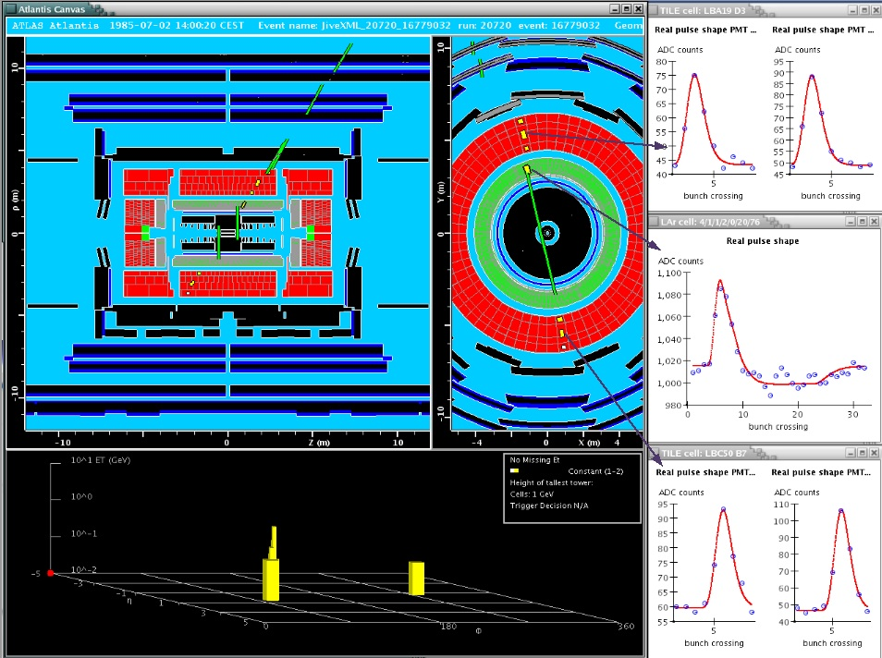
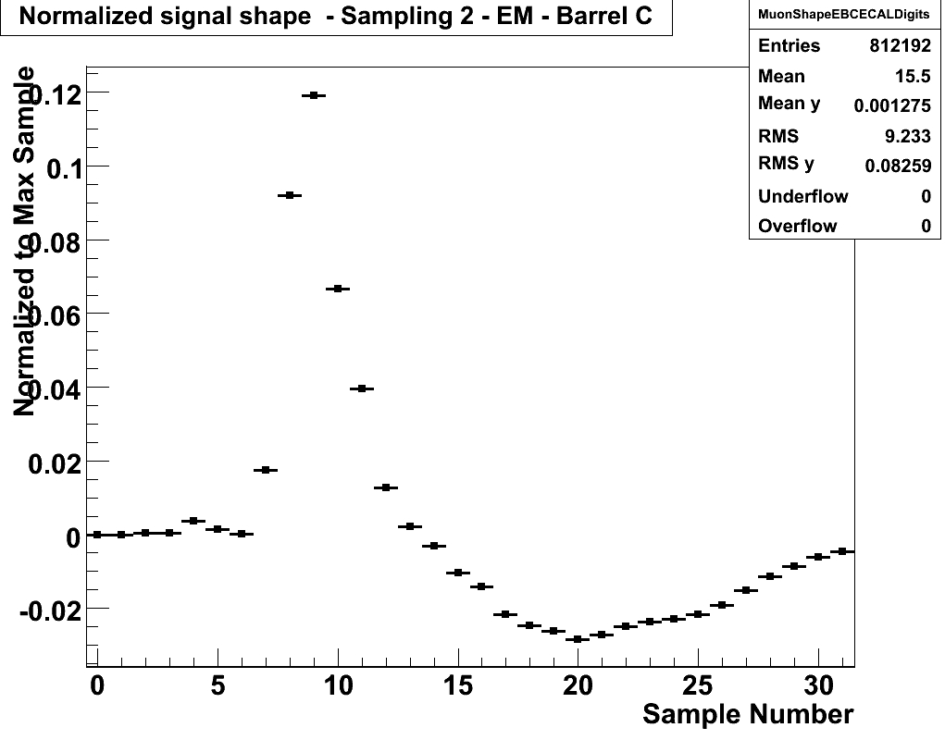
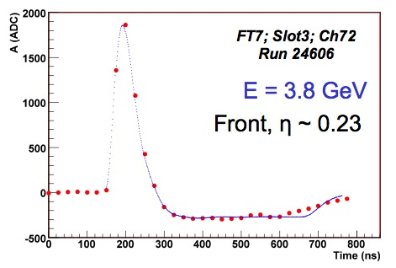
ATLAS – LAr calorimeter cosmic tests
First data taking with the full LAr detector (100%)
Many parameters already available in the online monitoring
  Digits, Noise, Timing, Cells, Clusters
LVL1Calo triggered events:
Averaged cosmic muon pulse shapes (online monitoring plot, full Barrel C averaged)
Shows good timing achieved over the whole detector
Single cosmic muon pulses fitting very well to the predicted pulse shape
19

Slide 20
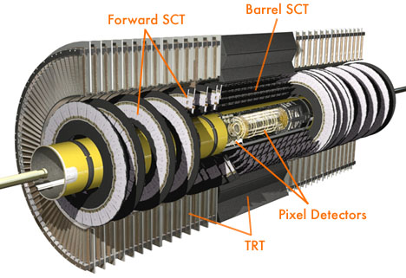
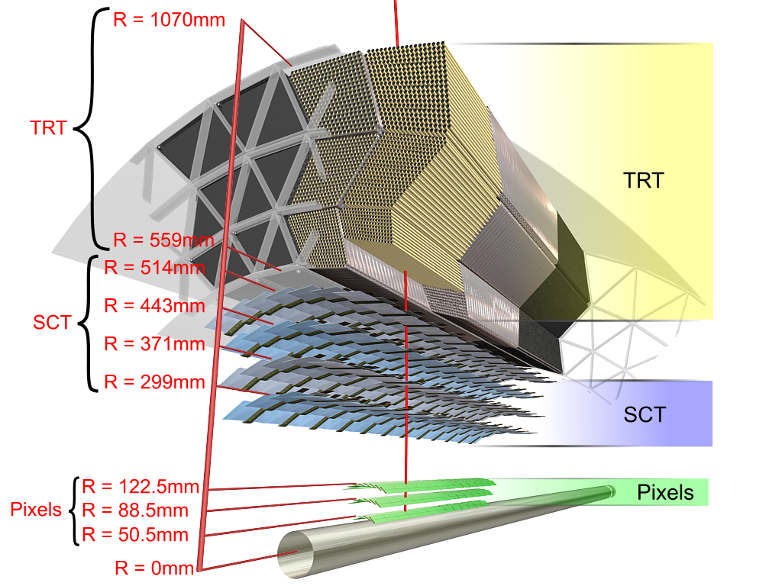
ATLAS – Inner Detector and Silicon Tracker (SCT)
All detector components installed:
  Barrel SCT + TRT
  2 End-Caps SCT + TRT
  Full pixel detector + Be beam pipe
  Commissioning of ID in progress

Slide 21
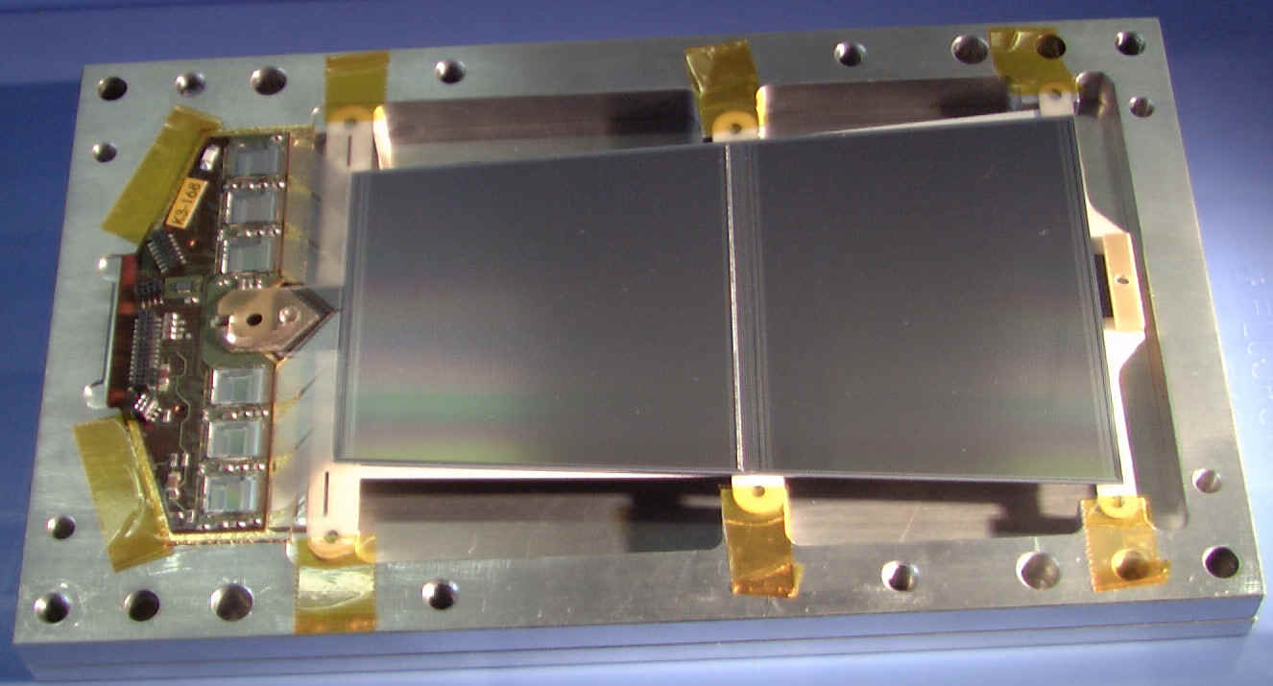
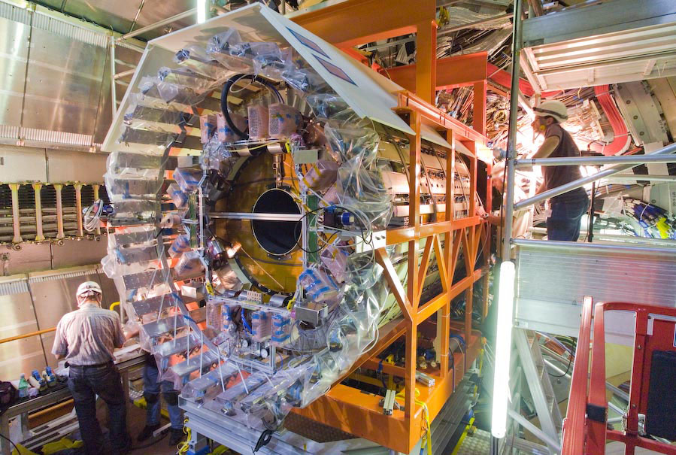
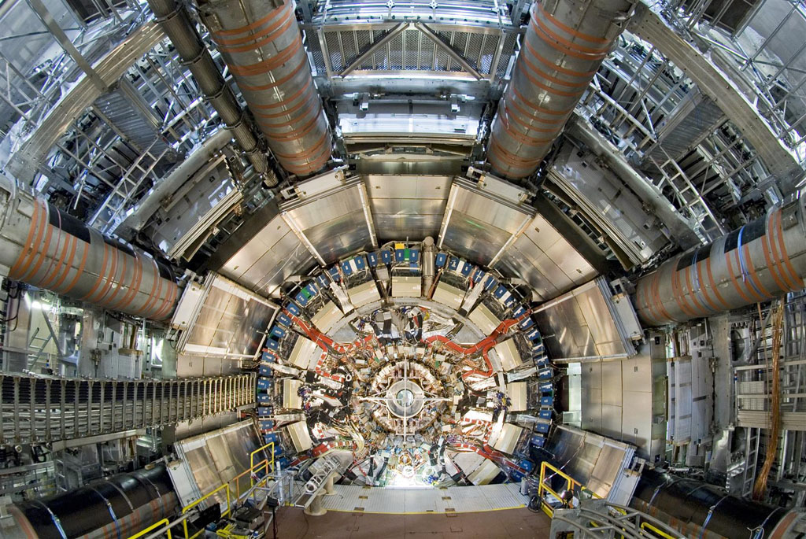
ATLAS – Inner Detector and Silicon Tracker (SCT)
SCT endcaps
650 out of 2000 forward silicon modules
mechanical engineering detector slow control
SCT surface commissioning:
only 0.3% dead channels

Slide 22
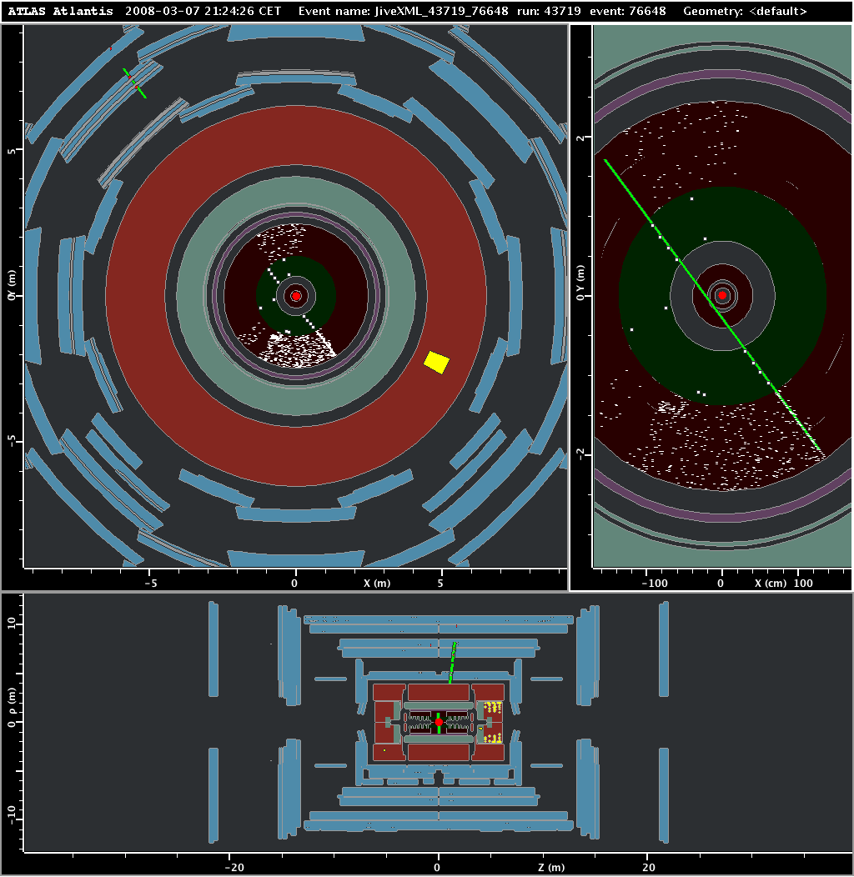
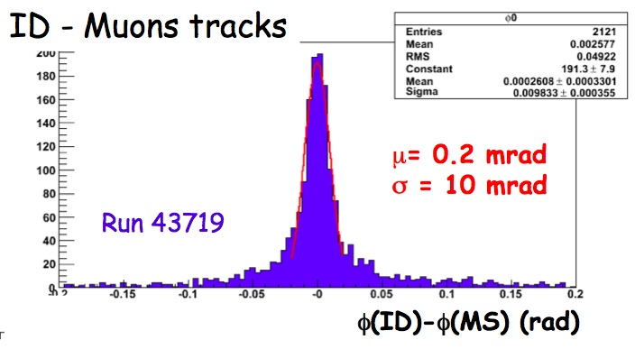
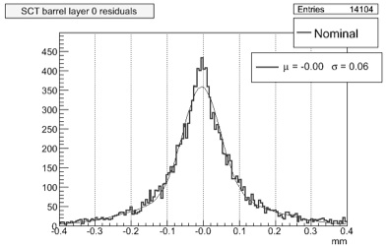
ATLAS - SCT Commissioning
Phi difference SCT+TRT, RPC track segment
Run first alignment checks ~ 5000 tracks
SCT residuals (GlobalChi2) σ~65μm without alignment.

Slide 23
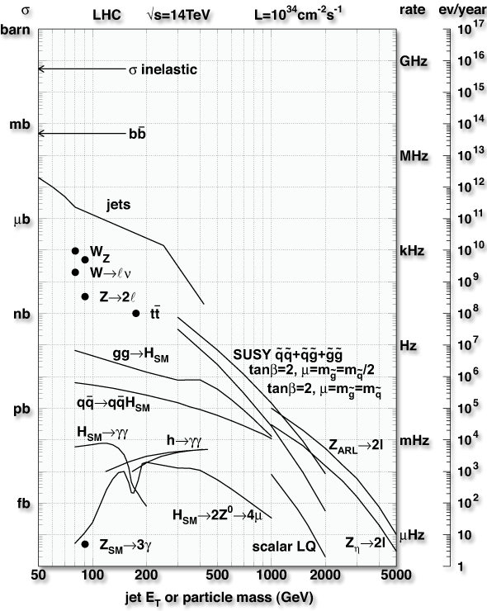

ATLAS and CMS – Expected Trigger Rates
Bunch crossing 40 MHz
σ total 70 mb
Event rate ~1 GHz
Number of events/BC ~25
Number of particles/event ~1500
Event size ~1.5 MB
Mass storage rate ~200 Hz
Event rate ➔
Level-1 ➔
Level-2 ➔
Need to have trigger of high performance
  6 orders of rate reduction
  complex events and 140 M channels
Mass Storage ➔
Level-1: hardware based at 40 MHz
Level-2: software based at 100 kHz
Level-3: event filter at 3 kHz
Storage at 100-200 Hz
3 Petabytes per year raw data for ATLAS
Similar for CMS and LHCb
PC
farms
Offline Analyses
strongly involved in trigger

Slide 24
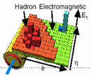
ATLAS – Trigger and Data Acquisition
Trigger
DAQ
Calo
MuTrCh
Other detectors
40 MHz
40 MHz
LV
L1
D
E
T
R/O
FE Pipelines
2.5 μs
RoI
Lvl1 acc = 75 kHz
75 kHz
ROD
ROD
ROD
Read-Out Drivers
RoI data = 1-2%
120 GB/s
120 GB/s
Read-Out Links
H
L
T
D
A
T
A
F
L
O
W
RoI
requests
ROS
~ 10 ms
RoI Builder
L2 Supervisor
LVL2
ROB
ROB
ROB
Read-Out Buffers
ROIB
L2SV
Read-Out Sub-systems
L2 N/work
L2 Proc Unit
L2N
L2P
~2+4 GB/s
~2 kHz
Lvl2 acc = ~2 kHz
EB
Dataflow Manager
DFM
EBN
Event Building N/work
~ sec
Event Filter
~4 GB/s
SFI
Sub-Farm Input
Event Filter
Processors
EFP
Event Builder
EFP
EFN
Event Filter N/work
EFP
EFP
EFacc = ~0.2 kHz
SFO
Sub-Farm Output
~ 200 Hz
~ 300 MB/s

Slide 25



ATLAS – DAQ and Event Filter Hardware
Hardware Installation and Thru-put
Many Swiss HLT activities:
  steering framework development
  persistency of trigger information
  level-2 calorimeter trigger calibration
  E_{T}miss trigger development
  trigger menus for physics in "express stream"
  online integration of HLT algorithms

Slide 26

The LHC experiments – LHCb
Table of personnel contributions.
UNIZh
EPFL

Slide 27

The LHC experiments – LHCb Experimental Area IP8
Detector installation completed
(except the first Muon Station not needed for the 2008 run)

Slide 28


LHCb – TT large surface silicon tracker by UniZh

Slide 29


LHCb – IT and TELLE-1 – EPFL
IT and Telle-1
inner silicon tracker
LHCb common
readout boards

Slide 30



The LHC experiments – the LCG computing challenge
Tier-0 at CERN
Tier-1 a large computer center (11 work for LHC, none in Switzerland) (work with Karlsruhe)
Tier-2 a regional center, e.g. CSCS in Manno (Ti).
Tier-3 at an institute
(not shown)

Slide 31



The LHC experiments – the Swiss T2 at Manno
For the three LHC experiments
in which Swiss groups participate
CMS
ATLAS
LHCb
Phase-A installed in Dec 07
(225 TB, ~800 kSI2k, 400 cores)

Slide 32

The LHC experiments – typical T3 at institute
CMS – T3 at PSI
ATLAS – T3 at Bern and Geneva
LHCb – T3 at Zurich and Lausanne
Example – ATLAS T3 in Geneva
ATLAS Grid site since 2005
local computing facility for the Geneva group
development and testing of trigger code
interactive and batch analysis
free CPU cycles used for ATLAS Monte Carlo production
current size
  61 machines, 188 CPU, 75 TB
  hardware used for 1st ATLAS data
  this Summer

Slide 33
The LHC experiments – ramp-up of Phoenix cluster
Actual ramp-up schedule ; calculations based on Q2/07 pricing,
installed in collaboration with SUN (phase-A completed 1/08)
Phases | Latest installation time | Minimum aggregate compute capacity [kSi2000] | Minimum available disc space [TB]
existing + CSCS GRID cluster | 2006/07 | 214 | 52
Phase A | Operational: 1/08 | ~800 | 225
Phase B | End 2008 | 1500 | 420
Phase C | End 2009 | 2600 | 800
Operation+repl. /a | >= 2010 | 2600 | 800
Cost estimates in kCHF
250
1120
~ 1300
~ 1300
~700
WAN: need > 3 Gbps in 2008/09
already 1 Gbps, can get 2x10 Gbps ☺
Personnel
physicist-informaticien at Manno attached to each experiment desirable
* 1 XEON 3 GHz ≈ 1.5 kSI2000

Slide 34
Conclusions
The LHC will start in coming months and will be the leading scientific instrument in particle physics in coming 10-15 years
  The coming 12 months will be an exciting but chaotic period for the CH groups and for the first analysis of data at Manno
The CH contribution to the LHC is important and the T2 centre in Manno is an essential element of support for the physics community
CHIPP is grateful to the CSCS for their strong collaboration in developing the T2 GRID capability for CH
We look forward to a continuing fruitful collaboration in the coming 15 years

