Slide 1
The LHC Computing Grid
The Computing Environment
for LHC Data Analysis
CHIPP Phoenix Cluster
Inauguration
Manno, Switzerland
30 May 2008

Slide 2
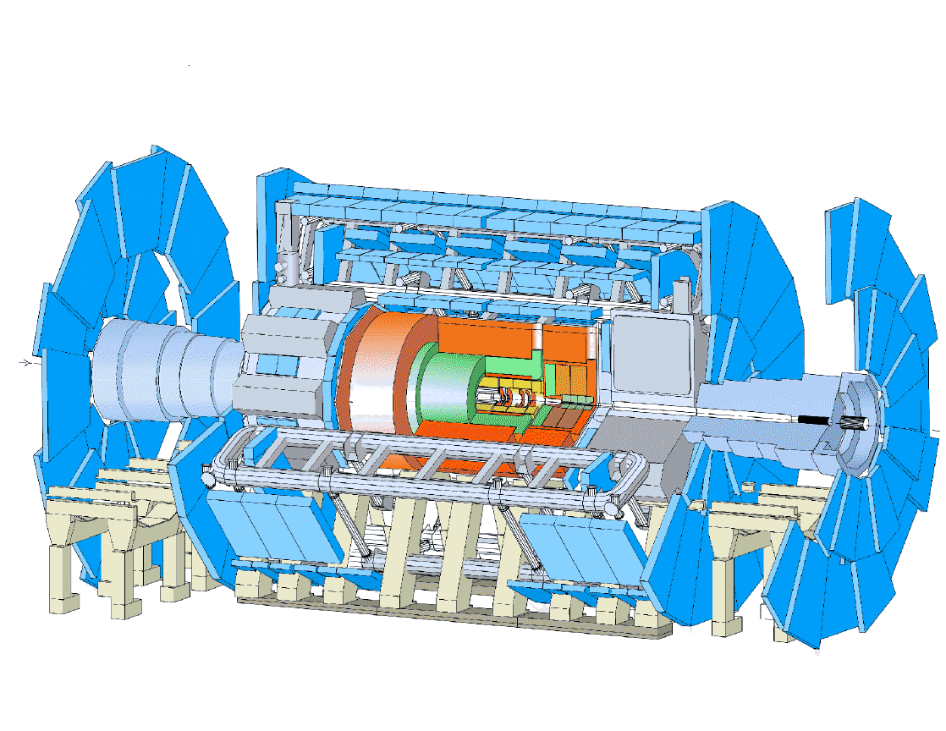
Data Handling and Computation for Physics Analysis
reconstruction
detector
event filter
(selection &
reconstruction)
analysis
event
summary
data
processed
data
raw
data
event
reprocessing
batch
physics
analysis
simulation
analysis objects
(extracted by physics topic)
event
simulation
interactive
physics
analysis
les.robertson@cern.ch

Slide 3
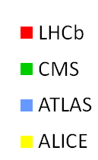
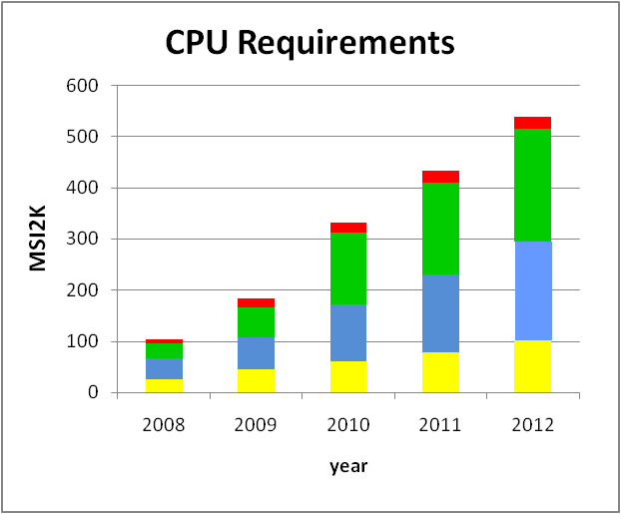
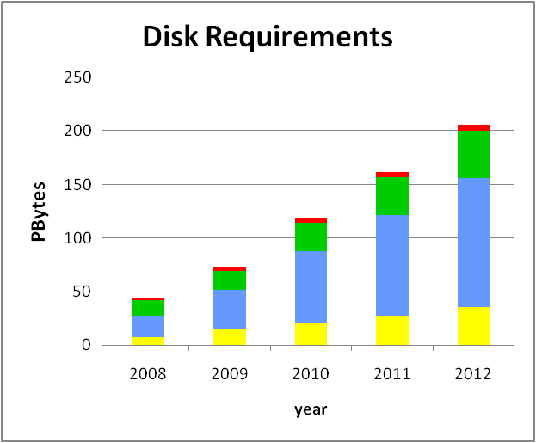
The Computing System for LHC DATA ANALYSIS
Capacity and Evolution
Computing requirements for all four experiments in first full year (2009)
~70 PetaBytes disk
~100K processor cores (2009)
used by > 5,000 scientists & engineers
Growth driven by new data, accelerator enhancements and improving efficiency, new analysis techniques, expanding physics scope, ....
disk storage growing at ~40 PB/year
BUT – evolution of access patterns unclear

Slide 4
The key characteristics of experimental HEP data analysis that dictate the design of the computing system
BUT --
enormous data collections
→ PetaBytes of new data every year
shared by very large user collaborations,
many different groups, independent
approaches to analysis
→ unpredictable data access patterns
independent events
→ easy parallelism
codes have
-- modest memory needs (~2GB)
-- modest floating point content
→ perform well on PCs
a simple distributed architecture developed
~1990 enabled experimental HEP to migrate
from supercomputers and mainframes to clusters
with the flexibility for easy evolution to new
technologies
and benefit from the mass market driven growth
in the performance and capacity of PCs, disks,
and local area networking
application
servers
mass
storage
data cache

Slide 5
Why did we decide on a geographically distributed computing system for LHC?
CERN’s budget for physics computing was insufficient
Easy parallelism, use of simple PCs, availability of high bandwidth international networking .... make it possible to extend the distributed architecture to the wide area ....
AND
The ~5,000 LHC collaborators are distributed across institutes all around the world with access to local computing facilities, ...
... and funding agencies prefer to spend at home if they can
Mitigates the risks inherent in the computing being controlled at CERN, subject to the lab’s funding priorities and with access and usage policies set by central groups within the experiments
ALSO
Active participation in the LHC computing service gives the institute (not just the physicist) a continuing and key role in the data analysis
-- which is where the physics discovery happens
Encourages novel approaches to analysis ....
... and to the provision of computing resources

Slide 6
What do we mean by a Computing Grid**?
Collaborating computing centres
Interconnected with good networking
Interfaces and protocols that enable the centres to advertise their resources and exchange data and work units
Layers of software that hide all the complexity from the user
So the end-user does not need to know where his data sits and where his jobs run
The Grid does not itself impose a hierarchy or centralisation of services
Application groups define Virtual Organisations that map users to subsets of the resources attached to the Grid
** There are many different variations on the term Grid – this is the HEP definition

Slide 7
The advantage for the computer centre is that the basic services can be provided in a standard way for different application groups
  e.g. user authentication, job submission, storage access, data transfer...
  ATLAS, CMS, LHCb, DZERO, ...., BioMed, Fusion, ....
The advantage for the application group is that it can integrate resources from different centres and view them as a single service without having to support all of the software layers, negotiate the installation of special software, register users on each site, etc.
But they have the flexibility to pick and choose – replace software layers with their own products, decide which services are provided at which sites, ....

Slide 8
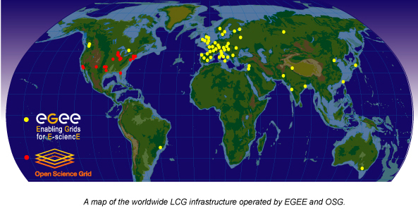
LCG depends on two major
science grid infrastructures
EGEE - Enabling Grids for E-Science (with EU funding)
OSG - US Open Science Grid (with DoE and NSF funding)

Slide 9
The Middleware for the Baseline Services needed for the LHC Experiments
- Information system
- Security framework
- Storage Element
- SRM interface to Mass Storage
dCache, DPM, CASTOR, STORM
- Basic data transfer tools –
Gridftp, srmCopy.
- Reliable file transfer service –
FTS
- Catalogue services –
LFC, Globus RLS
- Catalogue and data management tools – lcg-utils
- Compute element –
Globus/Condor-G based CE, Cream (web services)
- Reliable messaging service
- Virtual Organisation Management Services
- Database distribution services –
ORACLE streams, SQUID
- POSIX-I/O interfaces to storage
- Workload Management –
EGEE Resource Broker,
VO-specific schedulers
- Job monitoring tools
- Grid monitoring tools
- Application software installation
- GUIs for analysis, production
GANGA, CRAB, PANDA, ..
GRID – a simple idea -
Not so simple to implement it!
For LCG, grid interoperability is required at the level of the baseline service
→ same software or standard interfaces or compatible functionality

Slide 10
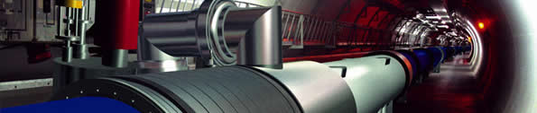
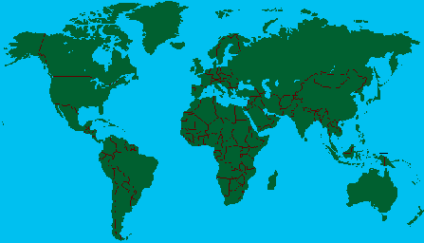
The LHC Computing Grid - A Collaboration of
4 Experiments + ~130 Computer Centres
Tier-0 – the accelerator centre
Data acquisition & initial processing
Long-term data curation
Distribution of data → Tier-1 centres
11 Tier-1 Centres – “online” to the data acquisition process
→ high availability
Managed Mass Storage –
→ grid-enabled data service
Data-heavy analysis
National, regional support
Canada – Triumf (Vancouver)
France – IN2P3 (Lyon)
Germany – Forschunszentrum Karlsruhe
Italy – CNAF (Bologna)
Netherlands – NIKHEF/SARA (Amsterdam)
Nordic countries – distributed Tier-1
Spain – PIC (Barcelona)
Taiwan – Academia SInica (Taipei)
UK – CLRC (Oxford)
US – FermiLab (Illinois)
– Brookhaven (NY)
Tier-2 – 120 Centres in 60 Federations in 35 countries
End-user (physicist, research group) analysis – where the discoveries are made
Simulation

Slide 11
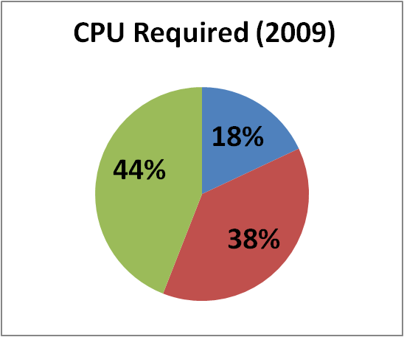
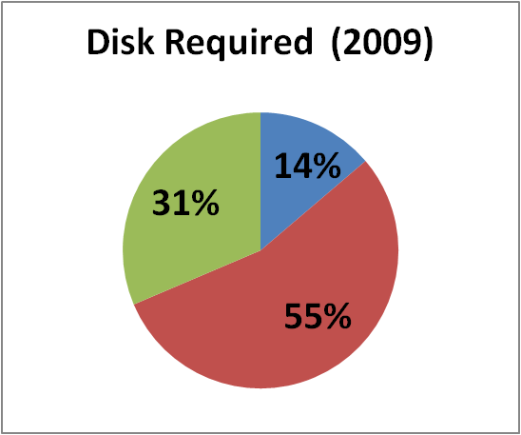
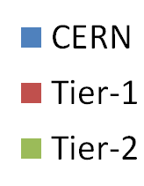
Distribution of Resources across Tiers
2009 – the first full year of data taking
<20% at CERN – less than half of that at the Tier-2s
→ the distributed system must work from Day 1

Slide 12
Middleware & Software
From many sources: Globus, Condor, EGEE gLite, High Energy Physics common tools and packages, experiments, open-source projects, proprietary packages, ...
Two fundamental middleware packages are integrated, tested and distributed by the infrastructure grids
  gLite by EGEE
  built on the Virtual Data Toolkit by OSG
The mass storage systems are crucial but complicated components of the LCG service – HEP developments
And a thick layer of software is maintained and distributed by the experiments (data management, resource scheduling, analysis GUIs, ..)

Slide 13

Experiment computing models define specific
data flows between CERN, Tier-1s and Tier-2s
Bologna
Fermilab
Karlsruhe
Lyon
ATLAS – EachTier-1 acts as the data
repository for a “cloud” of associated
Tier-2s.
cscs
Tier-2
Tier-2
Tier-2
CMS – Tier-2s send simulated data to
a specific Tier-1, but obtain data for
analysis from any of the 7 Tier-1s:
Taipei, Bologna, Fermilab, Karlsruhe,
Lyon, Barcelona, Ruther ford Lab
Vancouver
Bologna
Karlsruhe
Lyon
cscs
Hamburg
Freiburg
Prague

Slide 14




GridKa
IN2P3
TRIUMF
ASCC
Fermilab

Slide 15
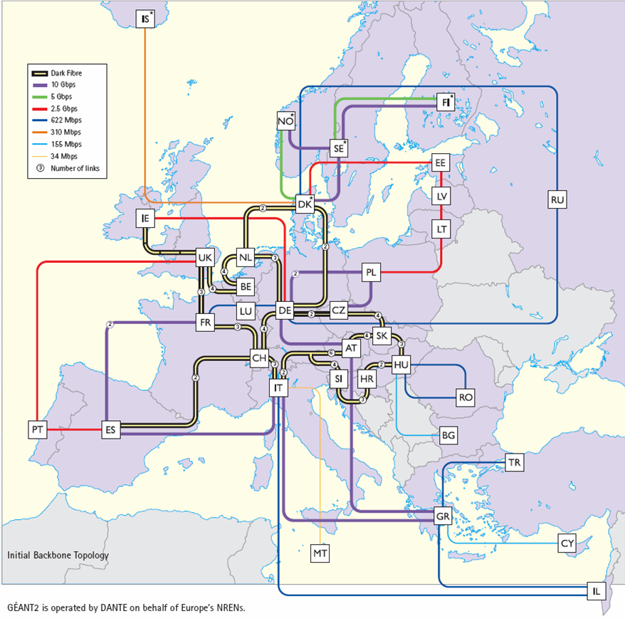


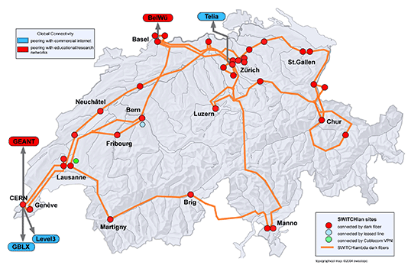
European Research Network Backbone

Slide 16
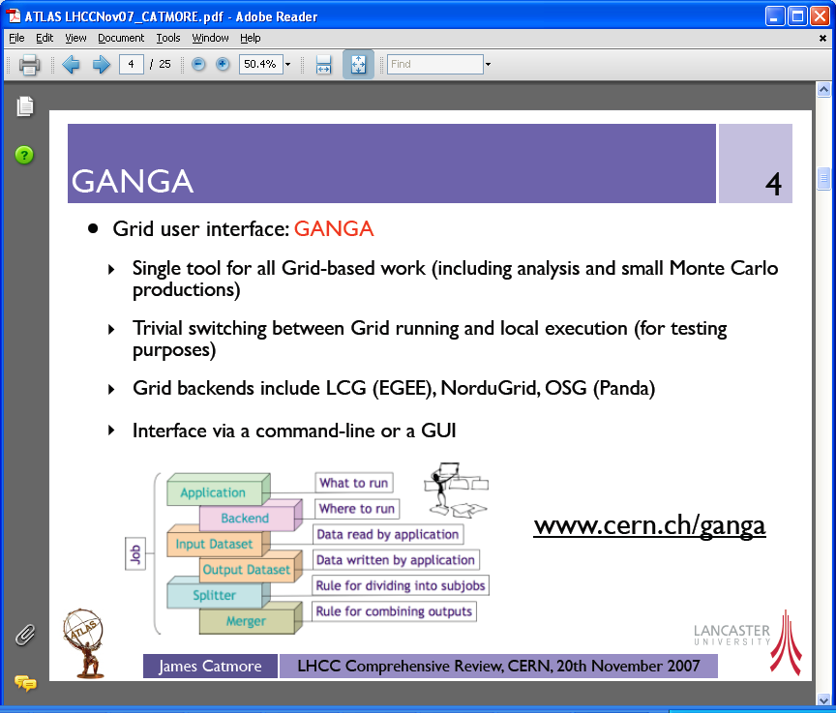

Slide 17
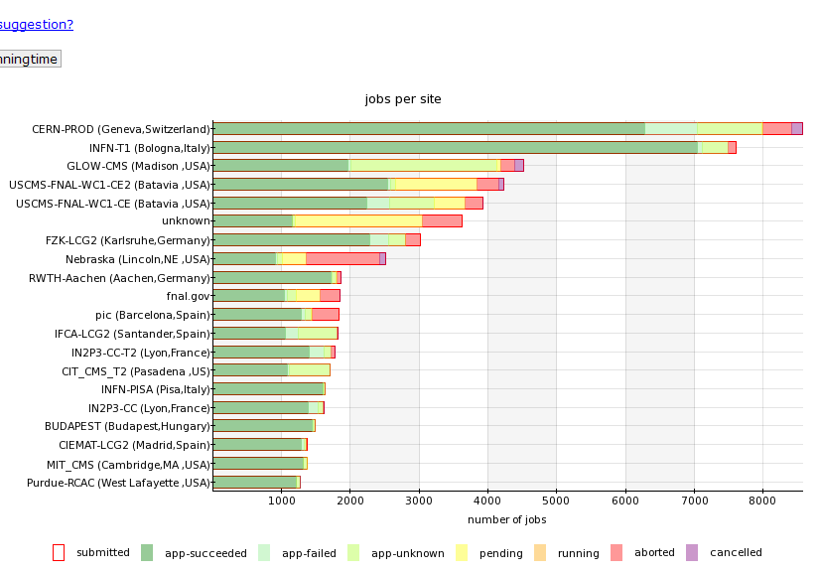
Experiment Dashboards provide tools for monitoring and debugging
CMS jobs May 2008 sorted by activities
Up to 200K jobs per day - 35% end-user analysis
ATLAS data transfer status - 28 May 2008
Throughput ~1100 MB/s
job status by site – user can drill down to find details of the errors

Slide 18
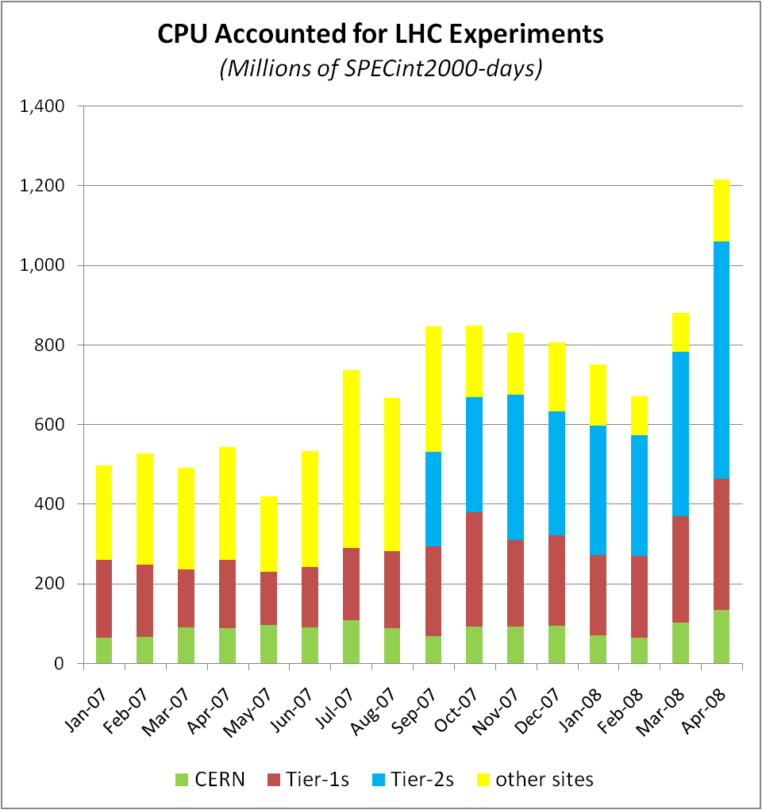
Evolution of LHC grid cpu usage
150% growth since Jan 07
More than half from Tier-2s
~800K core-days
~25K cores at 100% utilisation
~55% of committed capacity
Experiment services are still in test mode – awaiting the real data

Slide 19
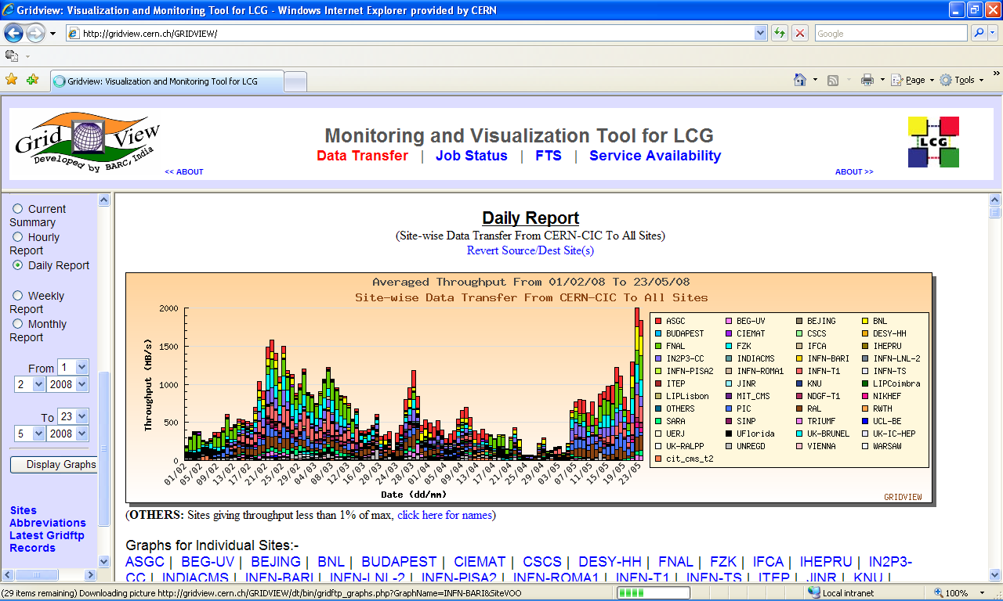
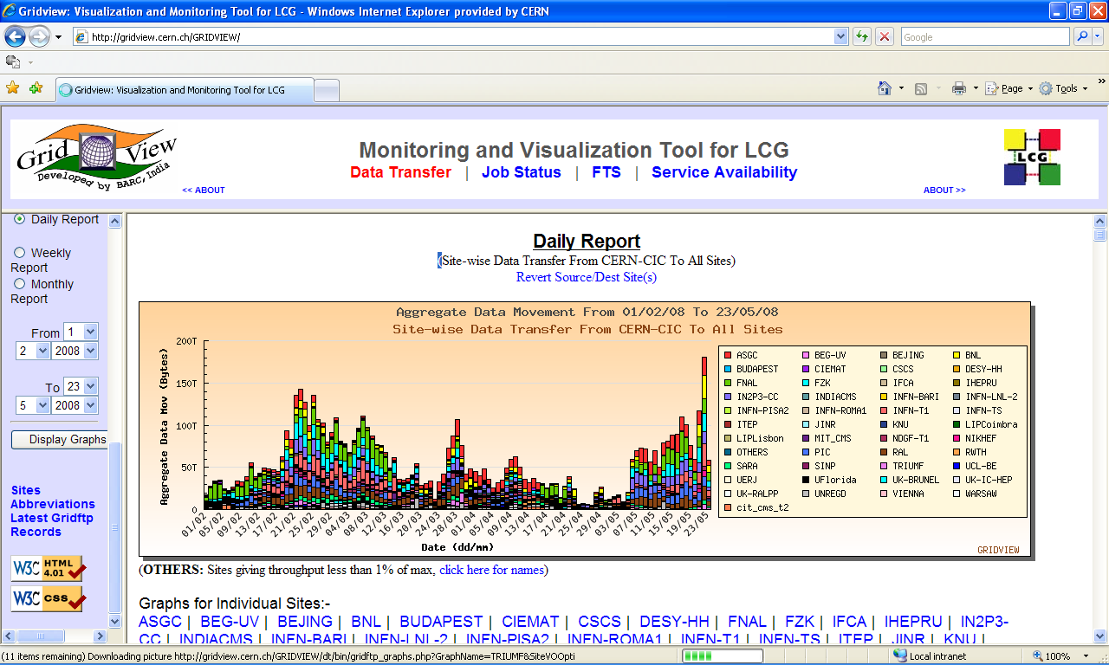
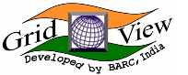
Data Transfer CERN→Tier-1s
TB/day
MB/sec
200
150
Sustained rate during data taking
100
50

Slide 20
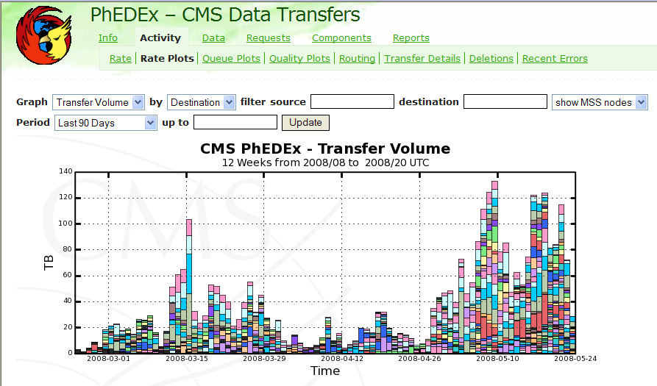
CMS Data Volume
TBytes/day - all sites to all sites

Slide 21
LHC Computing Grid Status Summary
The “final” pre-startup testing is now going on
→ all experiments exercise simultaneously their full computing chains - from the data acquisition system to end-user analysis at the Tier-2s – at the full 2008 scale
No show-stoppers since before the tests began in February – day-to-day issues being rapidly resolved
Most performance and scaling metrics have been achieved
BUT this is research ….
The actual load, access patterns, user behaviour is unpredictable – depends on how physicists react to
what they find in the real data
We can look forward to an exciting time when the beam starts!!

Slide 22
Summary
Grids are all about sharing
  they are a means whereby groups distributed around the world can pool their computing resources
  large centres and small centres can all contribute
  users everywhere can get equal access to data and computation
  without having to spend all of their time seeking out the resources
Grids also allow the flexibility to place the computing facilities in the most effective and efficient places –
  exploiting funding wherever it is provide,
  piggy-backing on existing computing centres,
  or exploiting cheap and renewable energy sources
The LHC provides a pilot application –
  with massive computing requirements, world-wide collaborations
  that is already demonstrating that grids can deliver in production
and the scientific success of LHC will depend on the grid from day 1

Slide 23
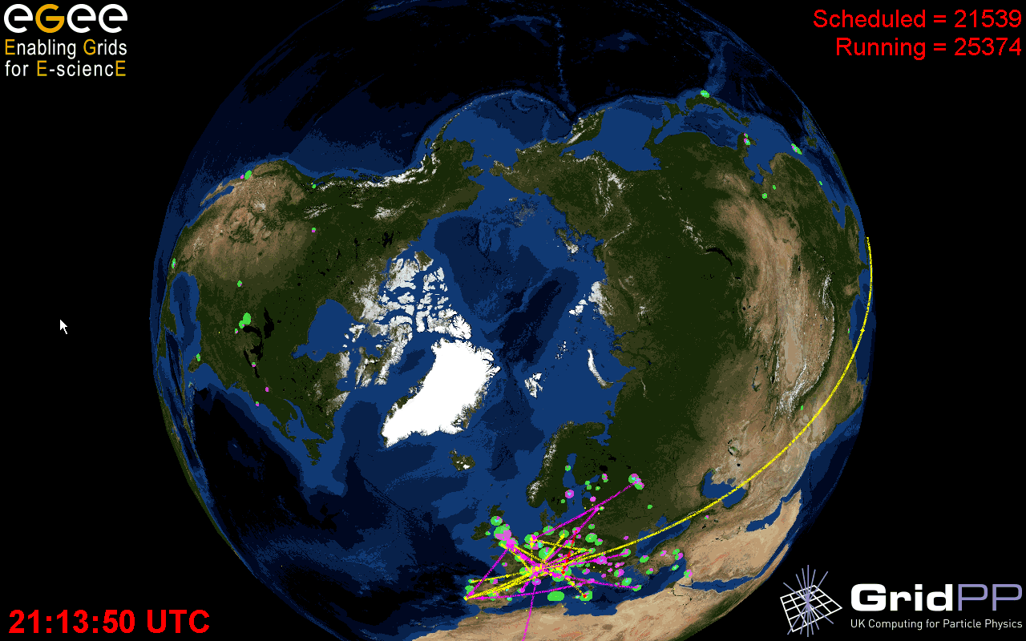
Computing at the Terra-Scale
Acknowledgements:
Julia Andreeva, Ian Bird, David Colling, David Foster, Jürgen Knobloch,
Faïrouz Malek, the LCG Collaboration, EGEE, OSG, the LHC experiments

